Slide 1
Advances in CyberShake Physics-Based Probabilistic Seismic Hazard Analysis
Scott Callaghan (SCEC), Phil Maechling, Fabio Silva, Christine Goulet, Kevin Milner, Mei-Hui Su, Xiaofeng Meng, Camilo Pinilla-Ramos, Kim Olsen, Rob Graves, Norm Abrahamson, Albert Kottke, Karan Vahi, Ewa Deelman, Tom Jordan, Yehuda Ben-Zion
December 9, 2024
AGU24: S21B – Probabilistic Seismic Hazard Analysis: Advances and Applications
scottcal@usc.edu

Slide 2
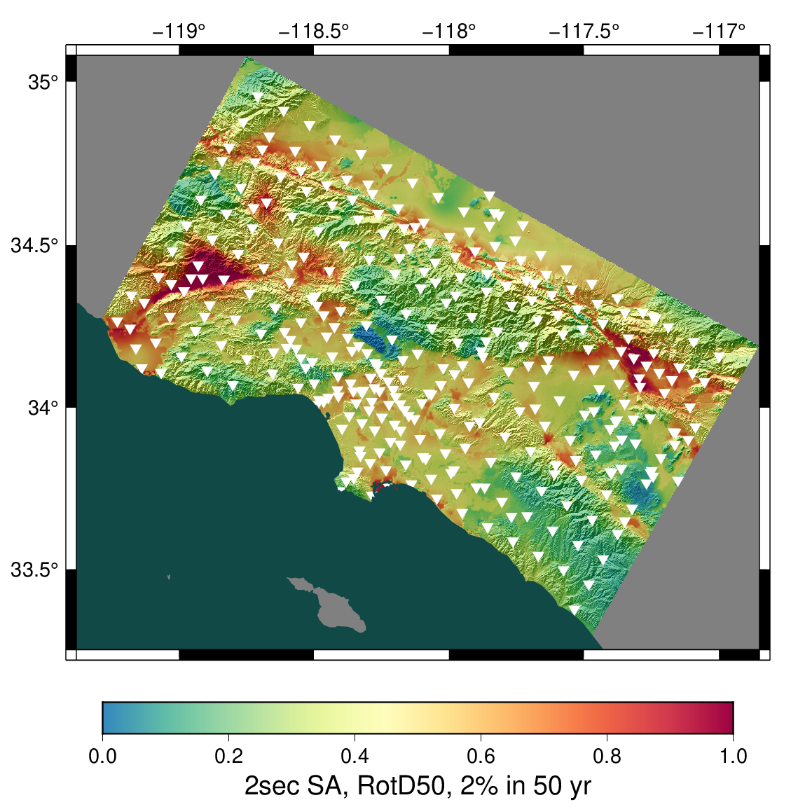
CyberShake overview
SCEC-developed 3D physics-based probabilistic seismic hazard analysis (PSHA) platform
Earthquake rupture forecast (ERF) provides list of relevant events + probabilities
Reciprocity-based approach to simulate low-frequency seismograms for sites of interest
Intensity measures derived from seismograms
Hazard results from sites interpolated for map
Stochastic high-frequency simulations added to produce broadband models
Hazard map from most recent Southern California CyberShake Study, 22.12. Each triangle is a site location.
Statewide California Earthquake Center | www.scec.org

Slide 3
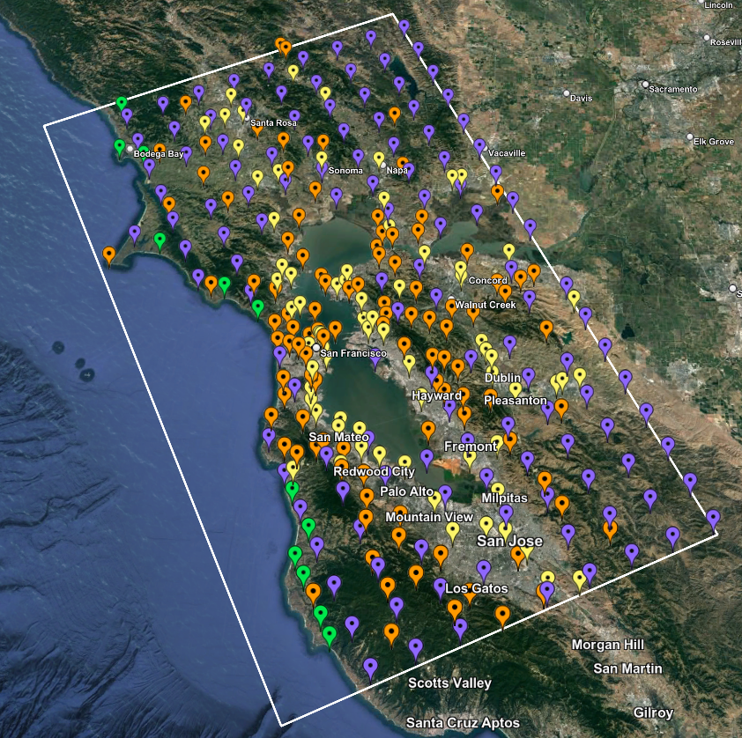
CyberShake Study 24.8: Northern California
Changes and updates:
Minimum Vs = 400 m/s
Removal of southern San Andreas events from ERF
Vertical component seismograms
Vertical response spectra
Period-dependent durations
Consistent with Southern CA Study 22.12:
UCERF2-derived ERF
Graves & Pitarka (2022) rupture generator
~200,000 events per site
1 Hz deterministic, 50 Hz broadband using modules from the SCEC Broadband Platform
Map of 315 Study 24.8 sites
Statewide California Earthquake Center | www.scec.org

Slide 4
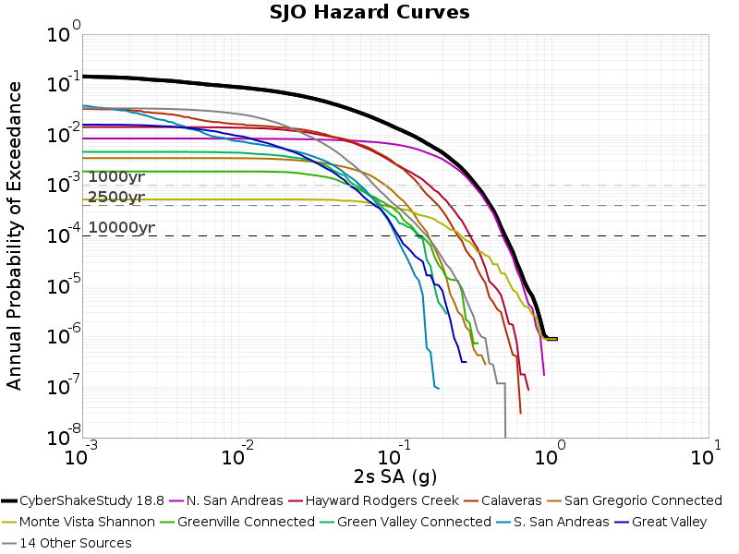
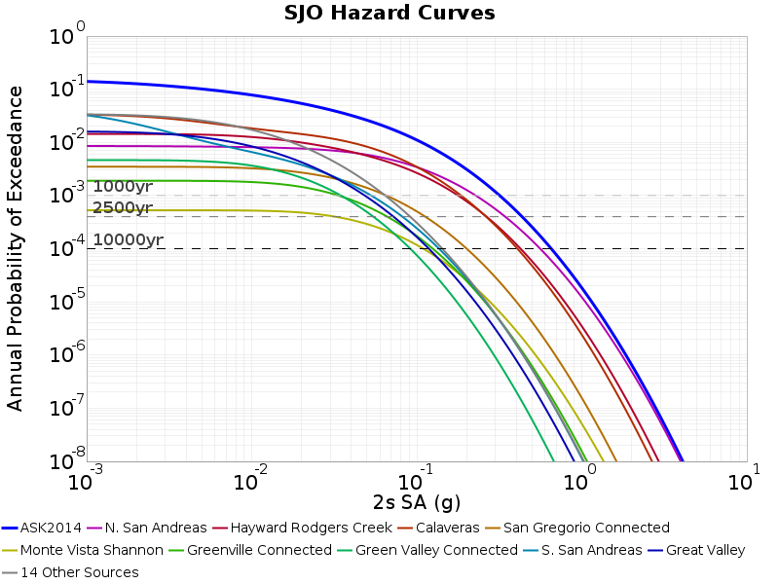
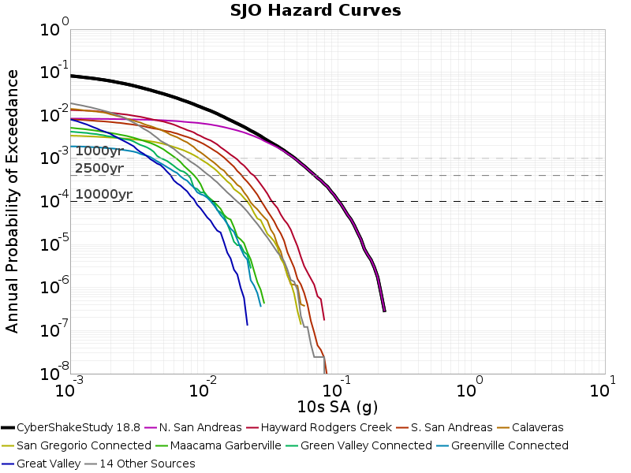
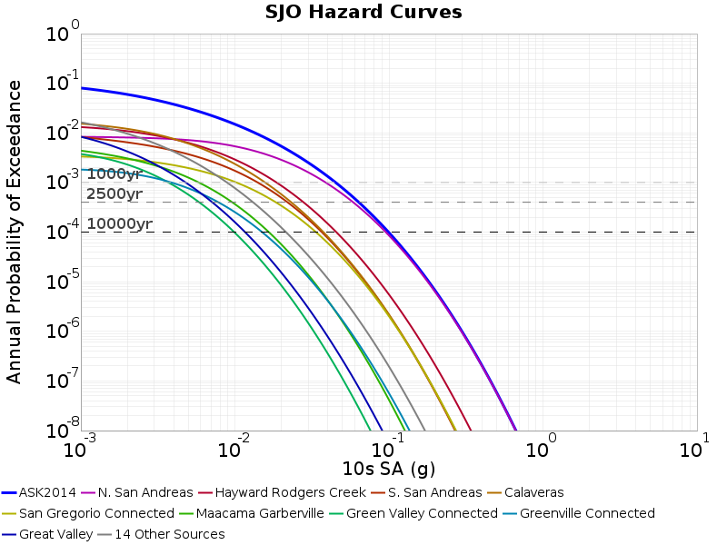
Changes and Updates
Removal of southern SAF events
For return periods > 1000 yrs, sSAF events have minimal contribution
Reduces volume size by ~40%
Minimum Vs reduced to 400 m/s
Modifications to velocity model
Vertical component seismograms
New derived data products:
Vertical response spectra
Period-dependent durations
CyberShake Study 18.8
ASK 2014
2 sec
10 sec
Hazard breakdown by source, site SJO
Statewide California Earthquake Center | www.scec.org

Slide 5
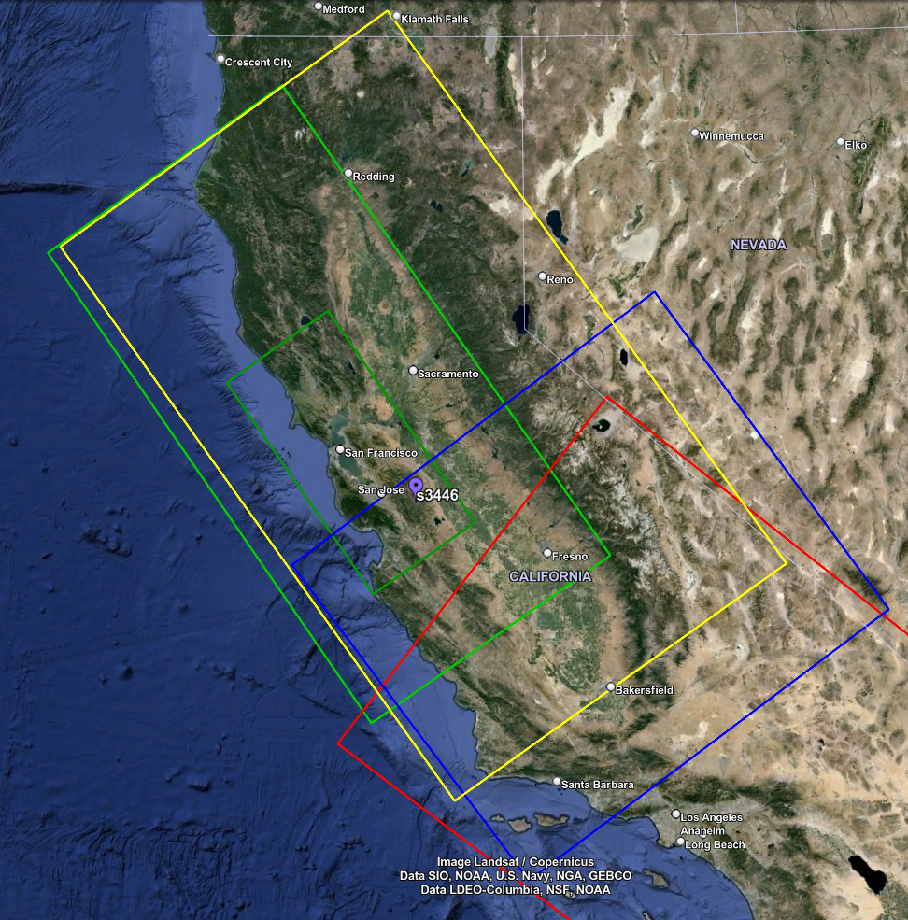
Velocity Model
Model consists of 3 tiled models
USGS SFCVM, v21.1
CCA-06 (tomographic model)
1D background model, based on Sierra geologic region in SFCVM
San Leandro Gabbro modification applied to SFCVM to reduce near-surface velocities
Smoothing applied 20km from all interfaces
Surface point populated at depth of 20m (80m grid spacing)
Vp/Vs ratio capped at 4
Sample simulation volume with tiling
Statewide California Earthquake Center | www.scec.org

Slide 6
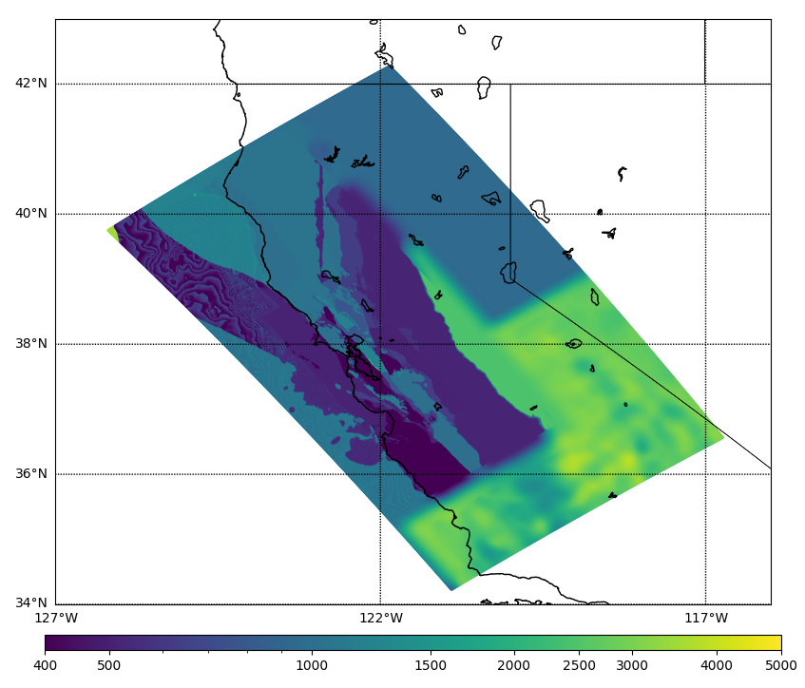
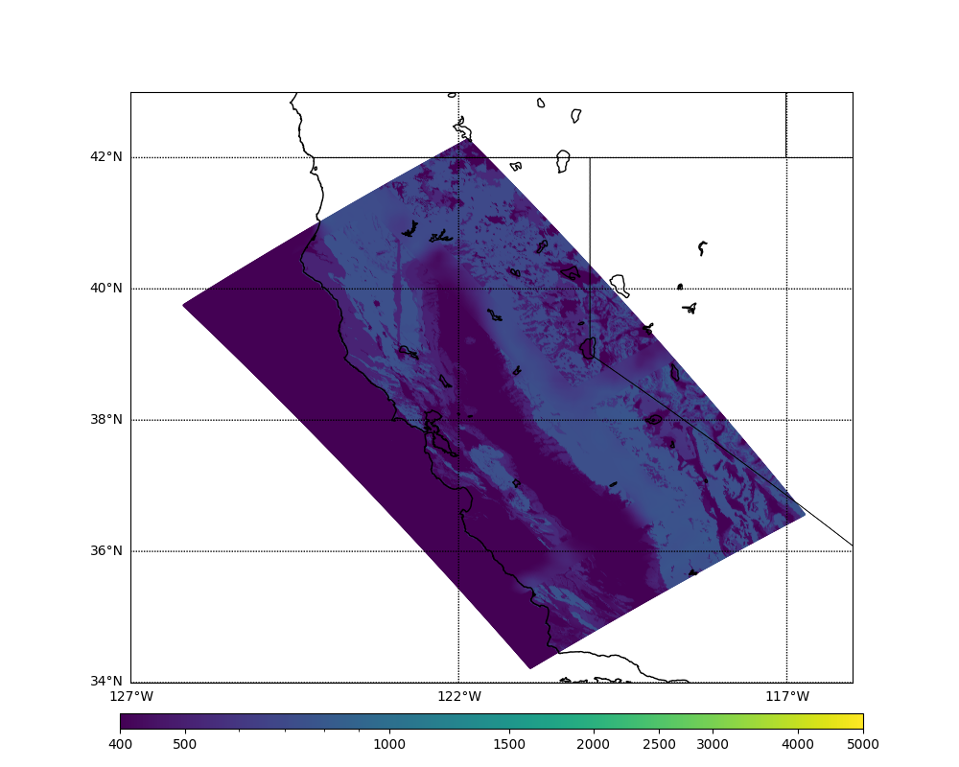
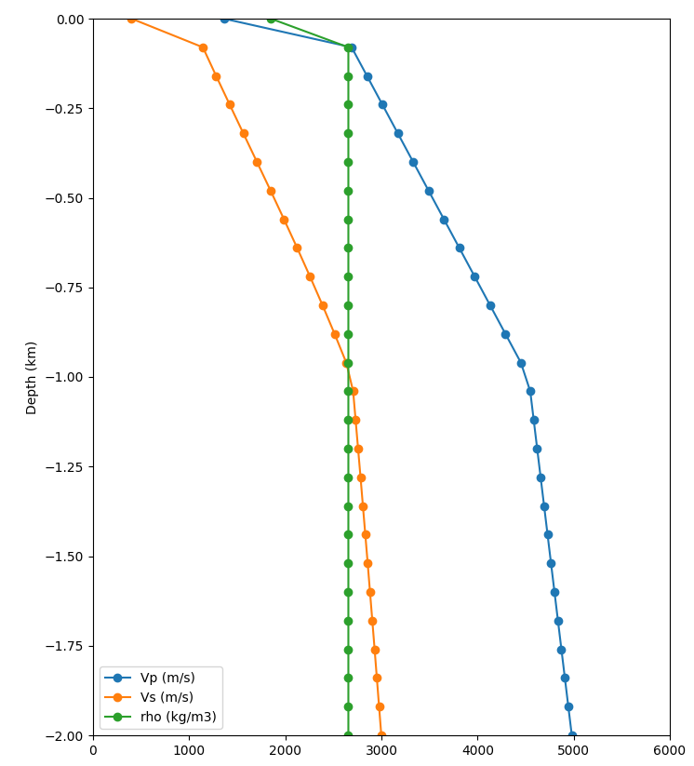
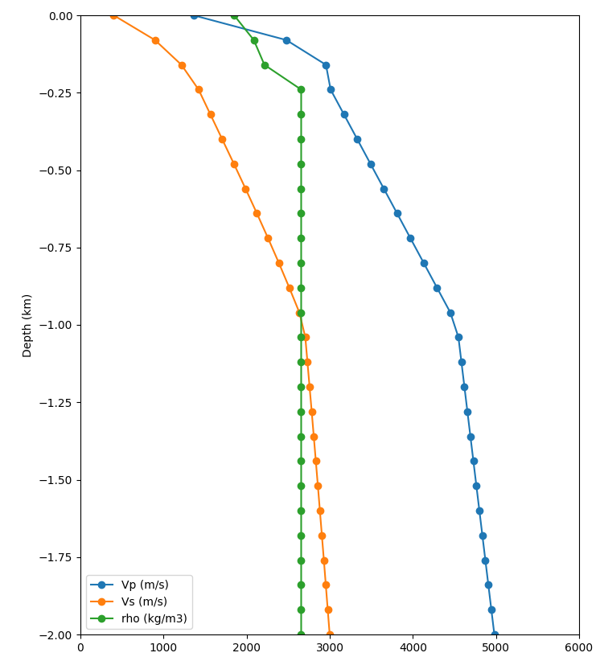
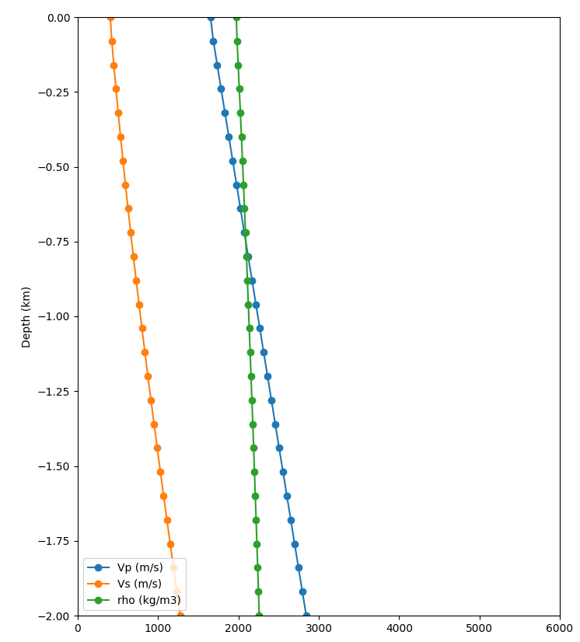
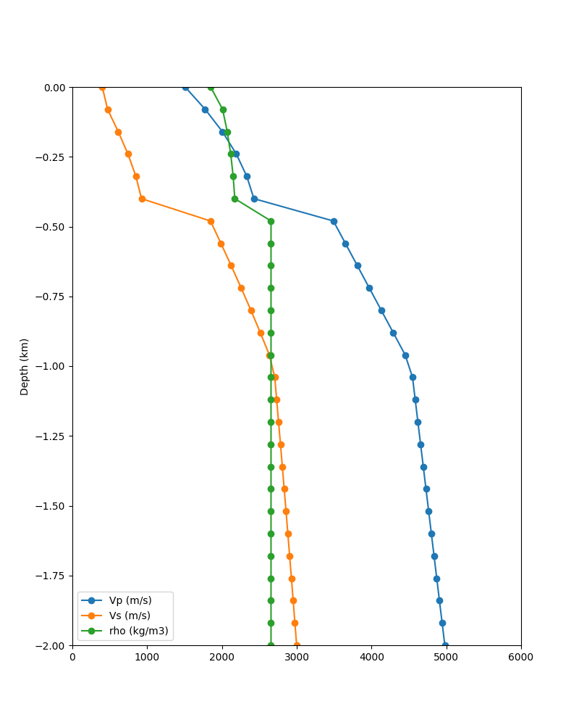
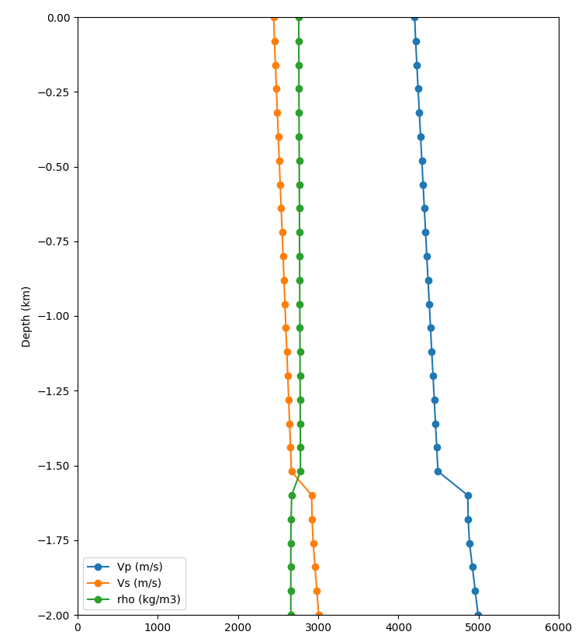
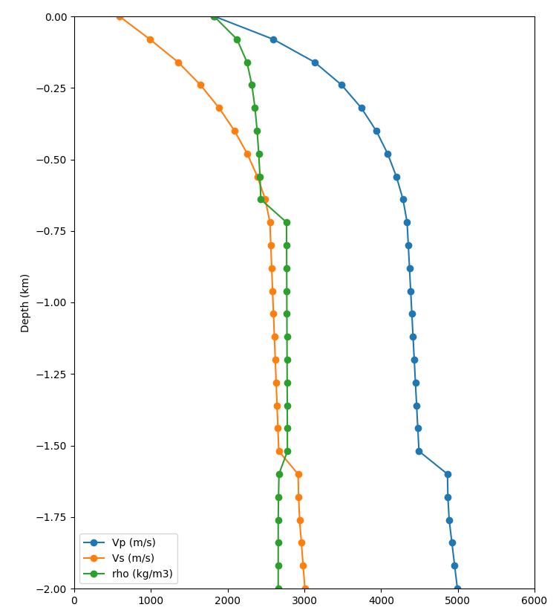
Merged Taper
Apply Thompson Vs30-based taper to grid points in top 700m if resulting Vs is lower
Before taper
After taper
Before taper
After taper
Surface slice, no taper
Surface slice, merged taper
Statewide California Earthquake Center | www.scec.org

Slide 7
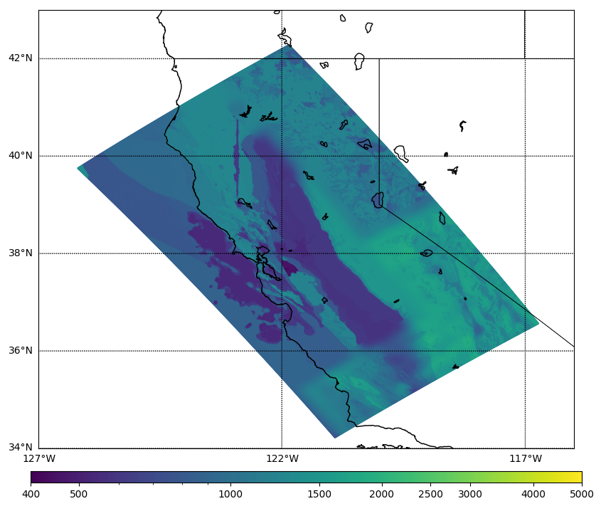
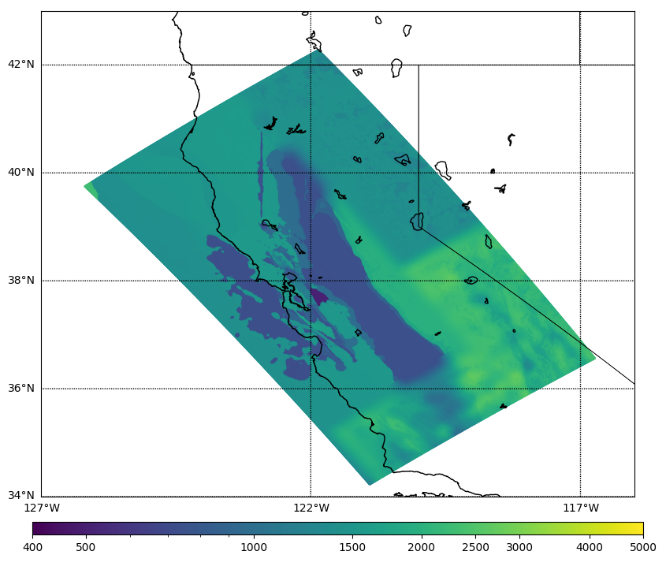
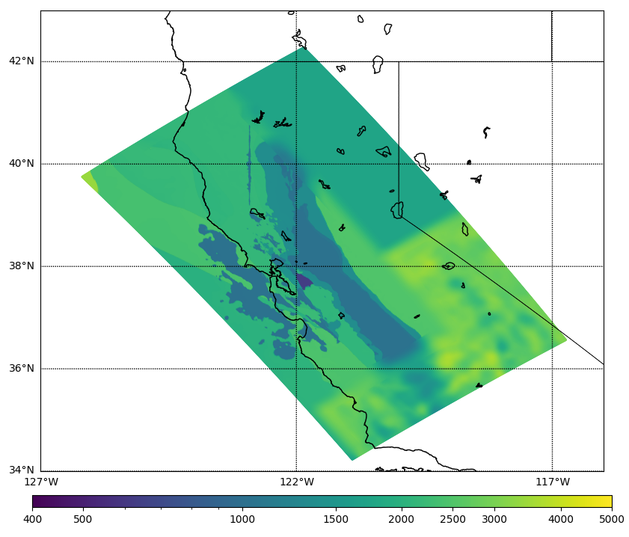
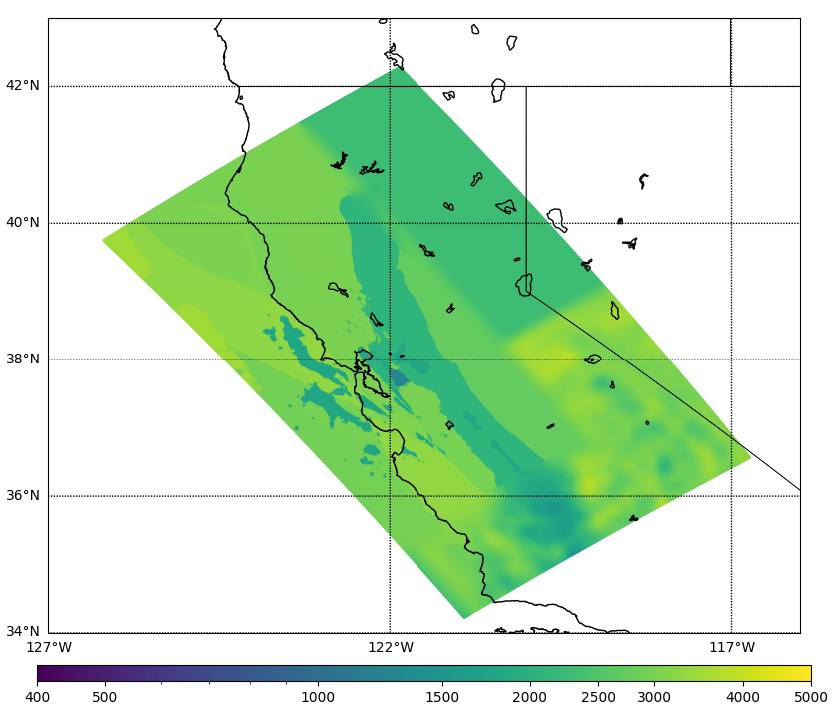
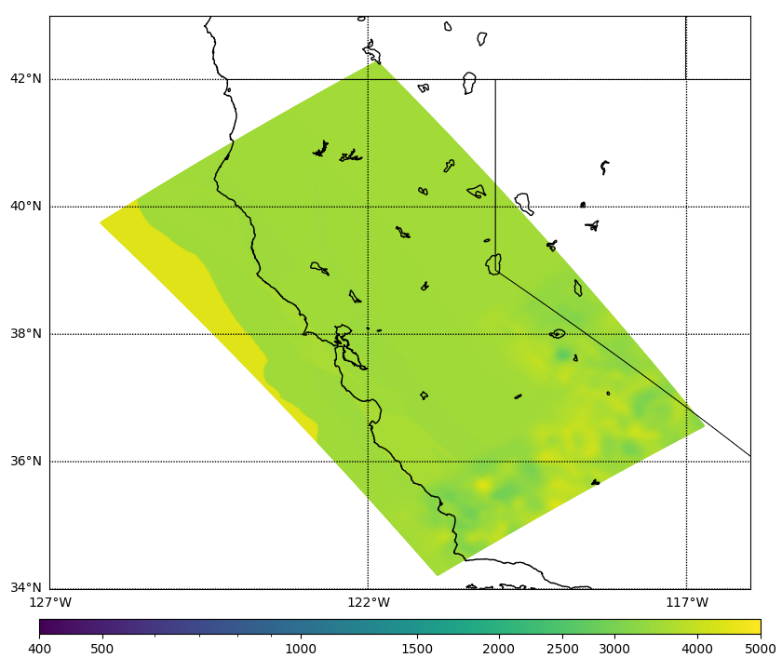
Velocity Model Slices
Surface
160 m
320 m
640 m
2000 m
10000 m
Statewide California Earthquake Center | www.scec.org

Slide 8
Study 24.8 Statistics
September 24 – November 8 (45 days)
Ran wave propagation calculations on OLCF Frontier and low-frequency synthesis and stochastic simulations on TACC Frontera
Used about 180,000 node-hours, including up to 44% of Frontier
Ran 27,800 jobs using Pegasus-WMS and HTCondor workflow tools
Managed 1 PB of data
Produced 36 TB / 9 million files of output data products
Generated 126.8 million three-component seismograms and 34.3 billion IMs
Statewide California Earthquake Center | www.scec.org

Slide 9
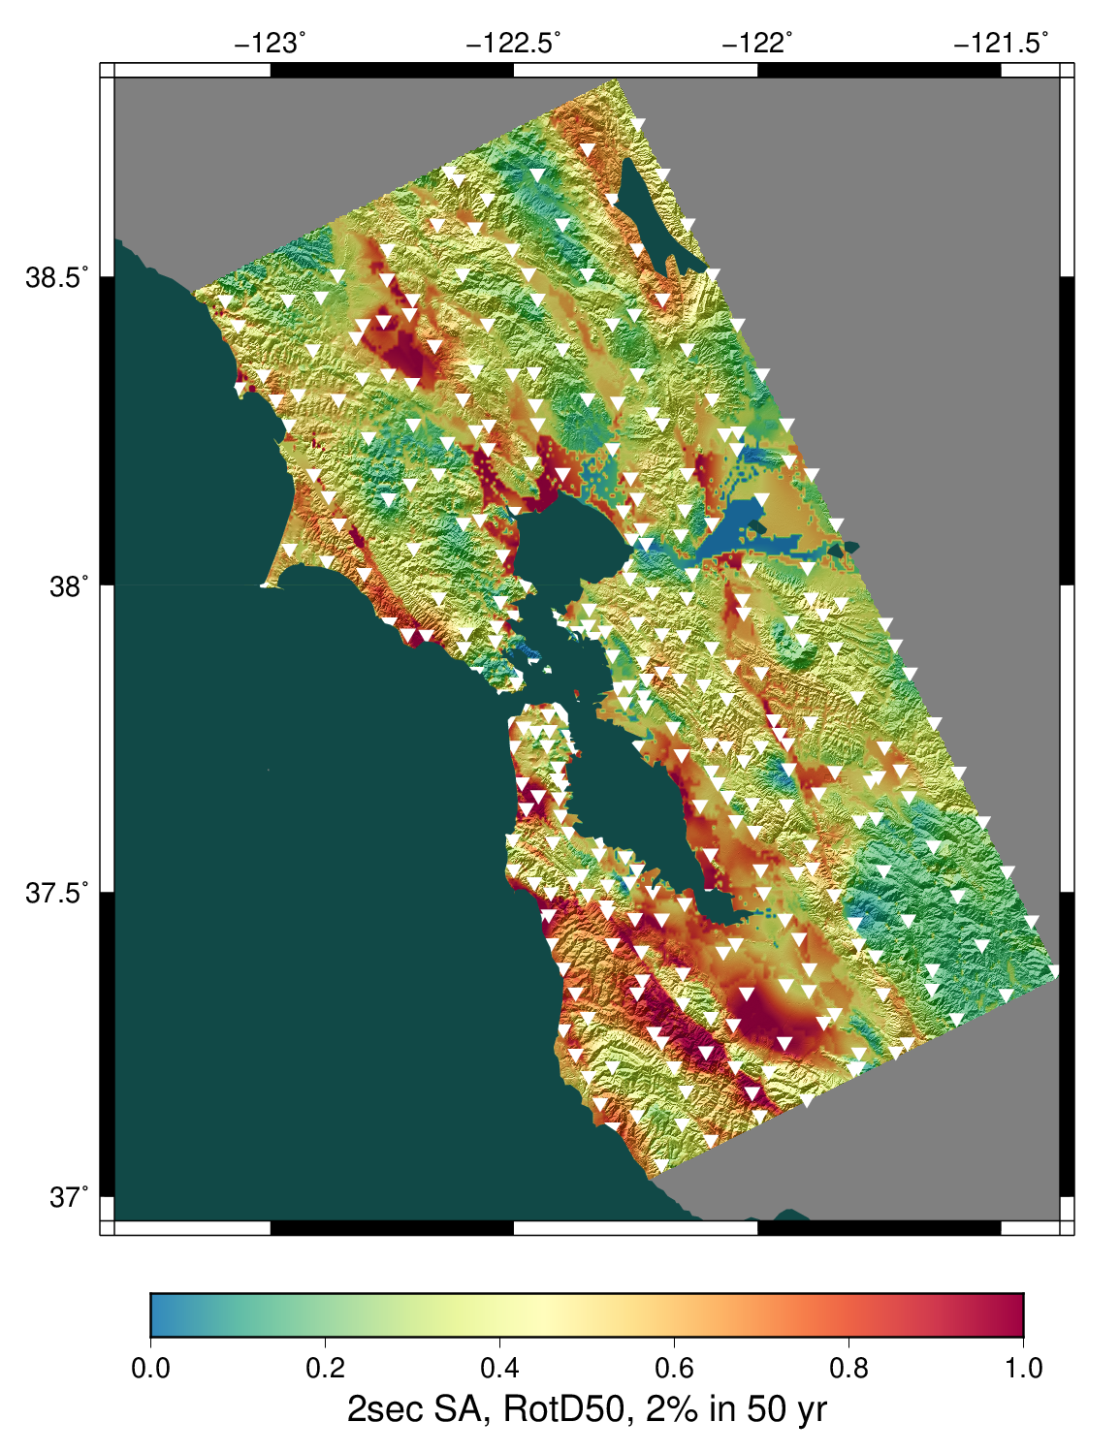
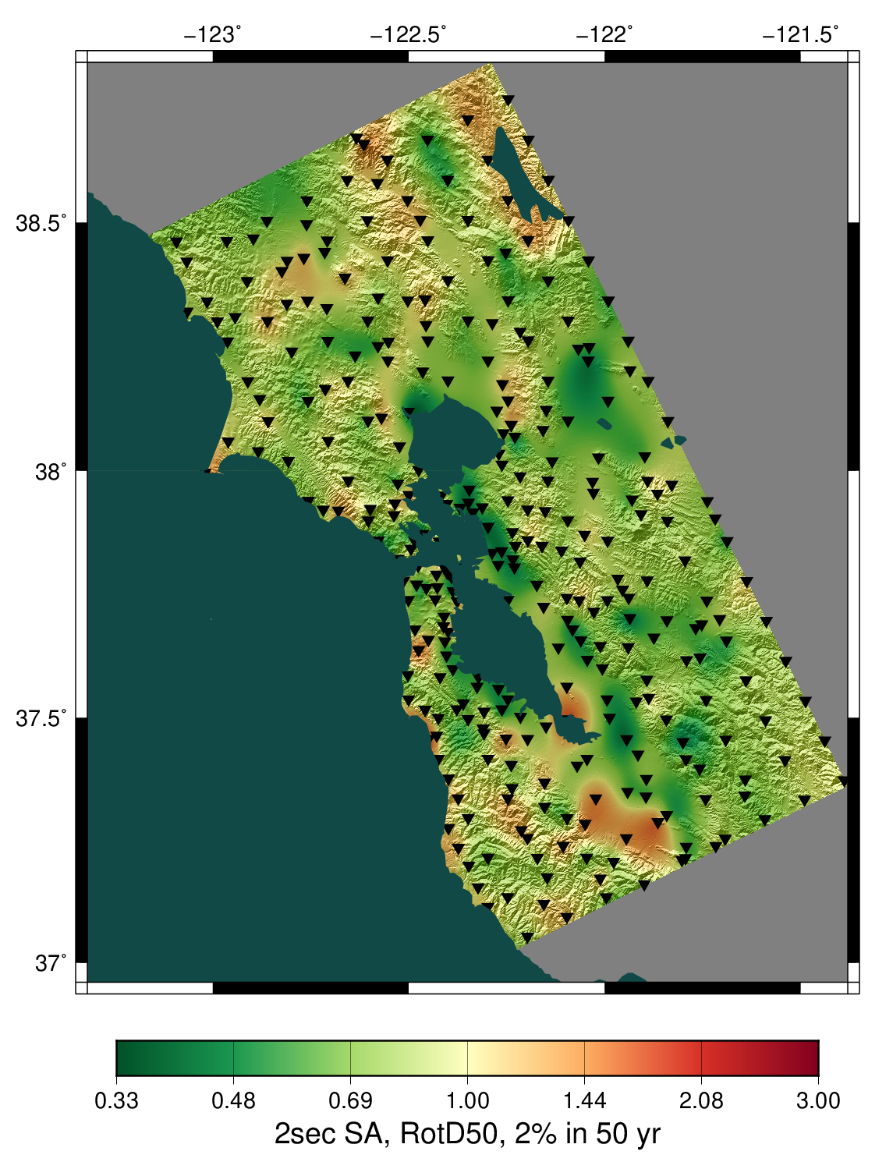
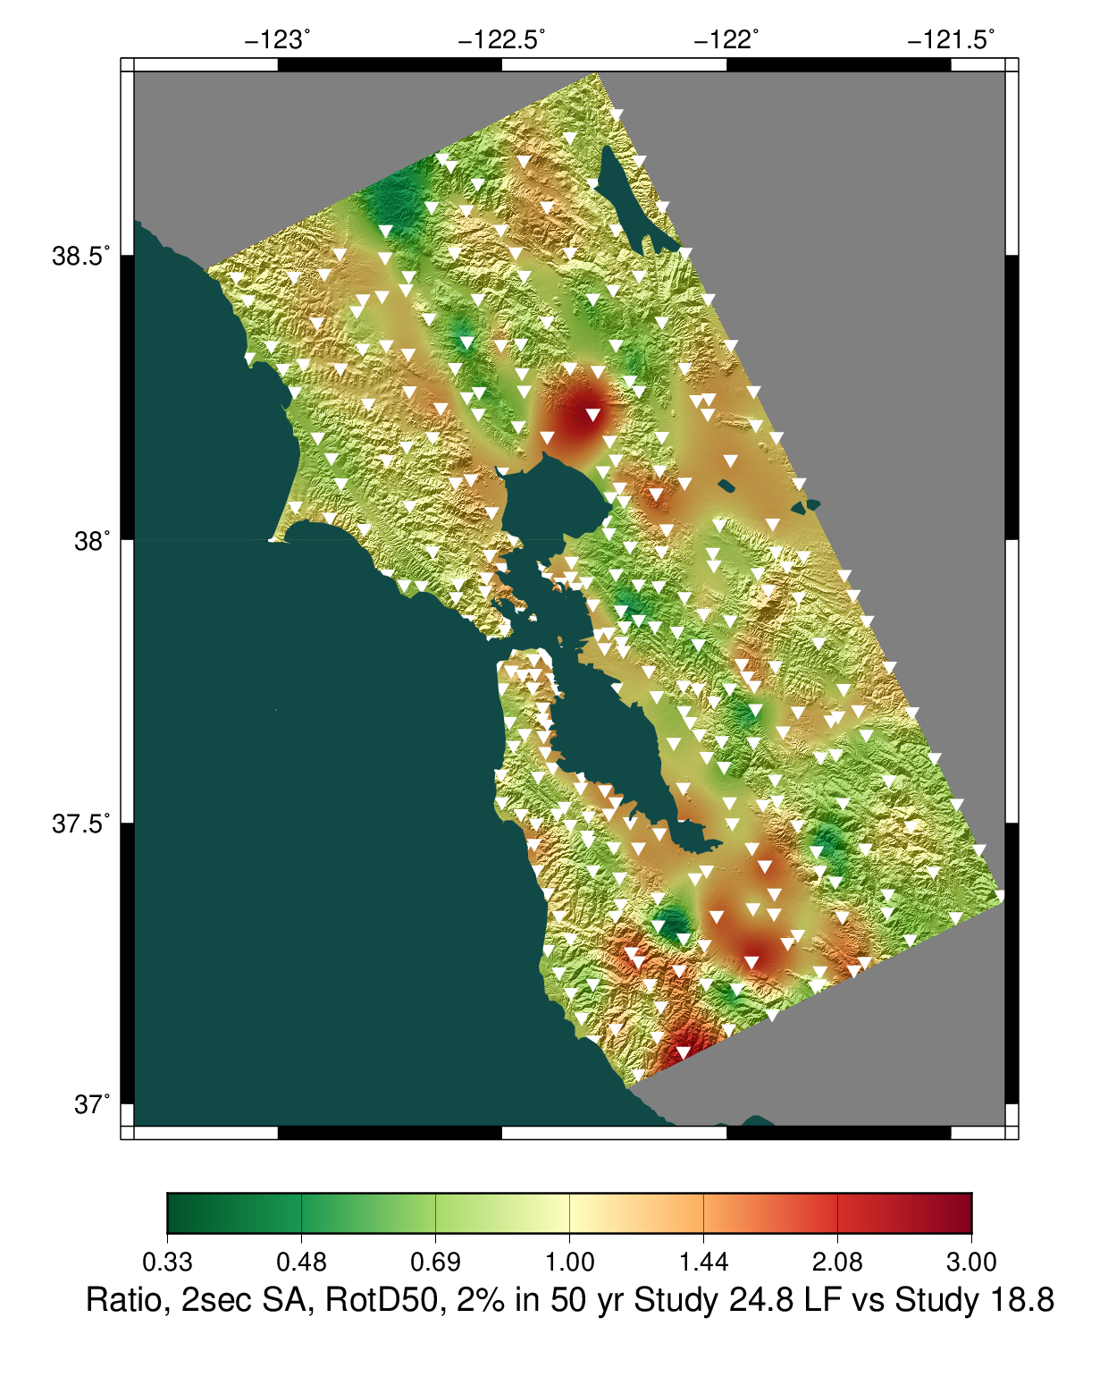
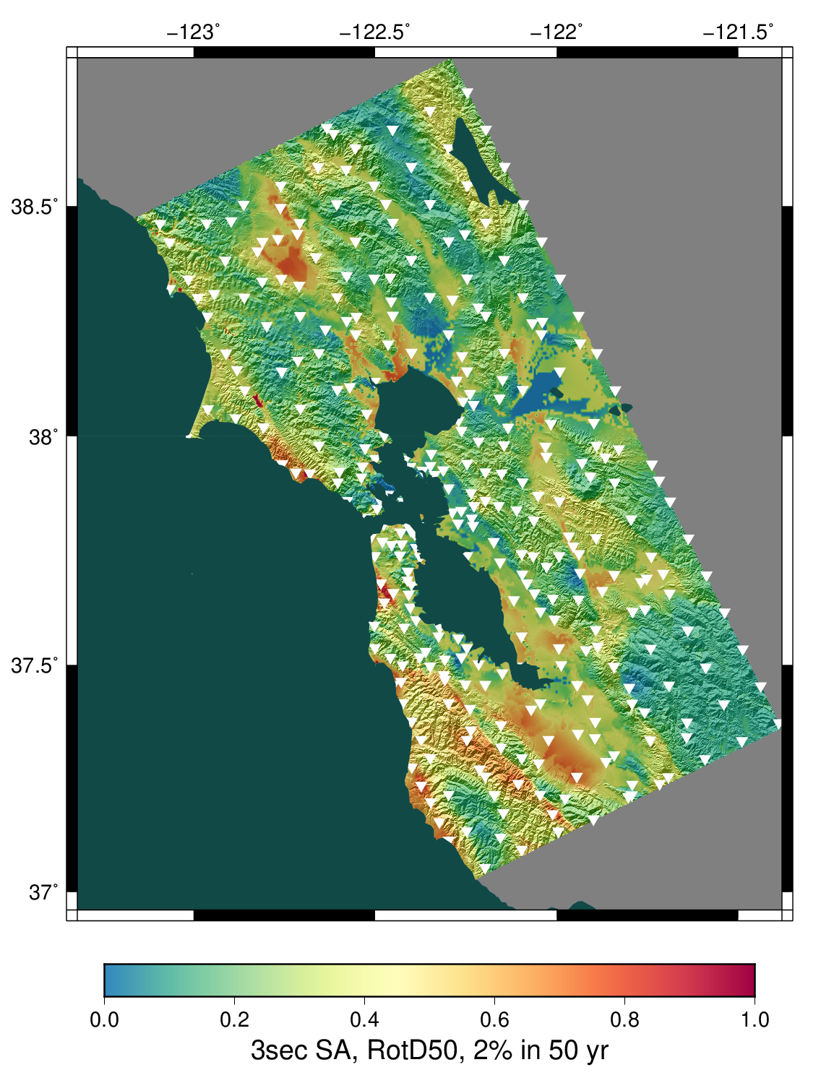
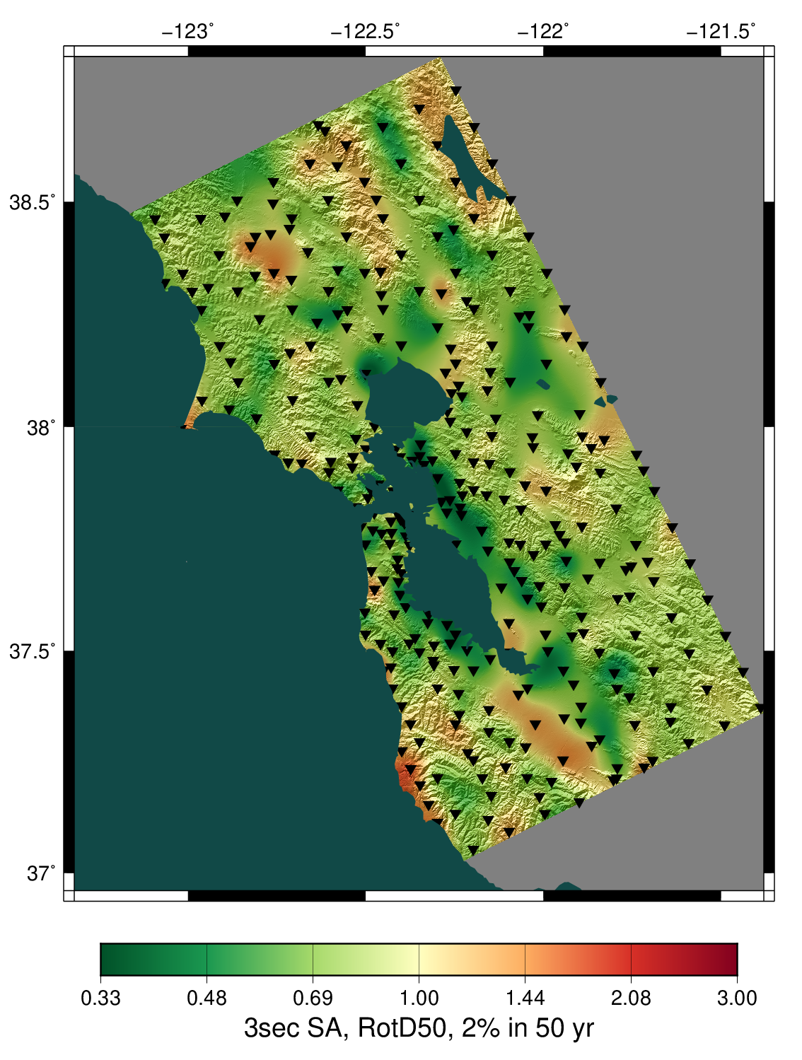
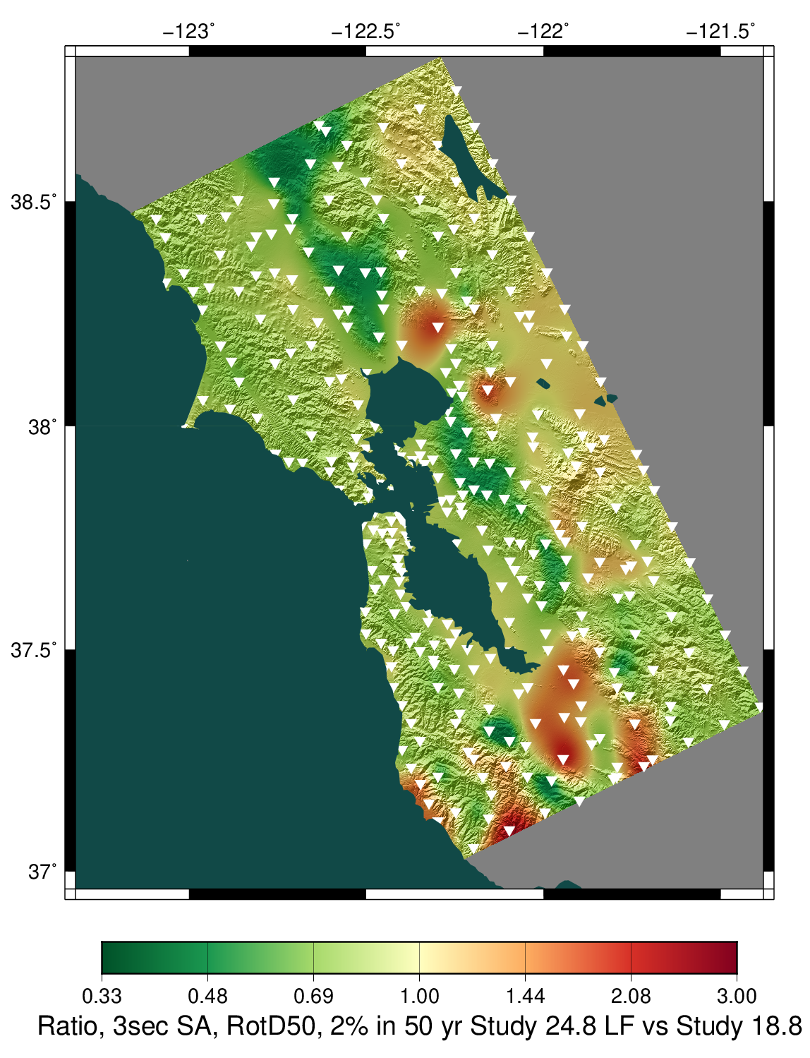
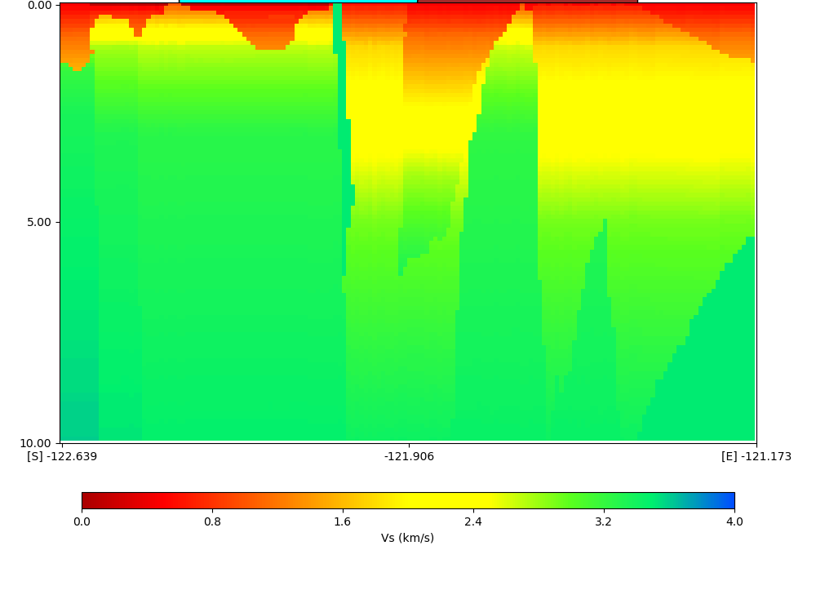
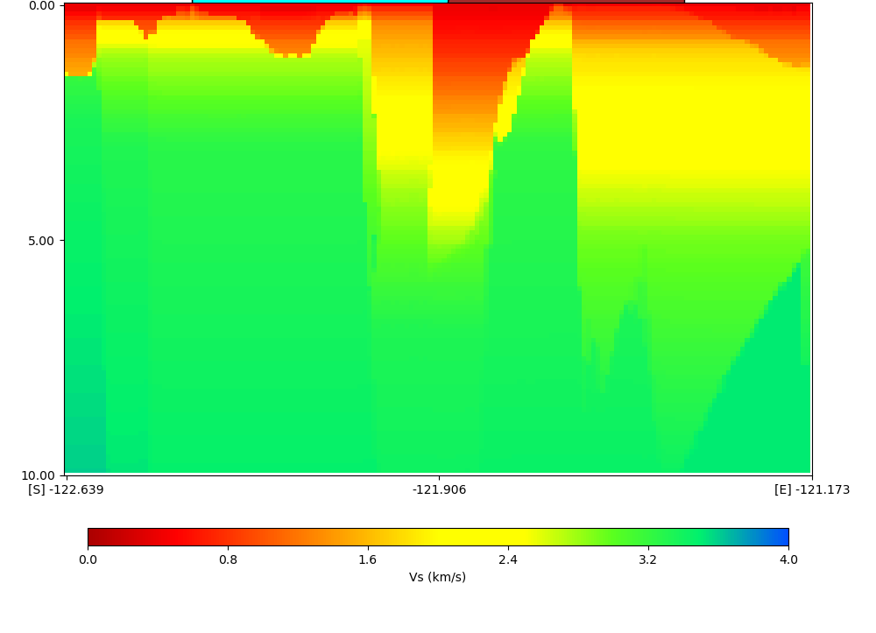
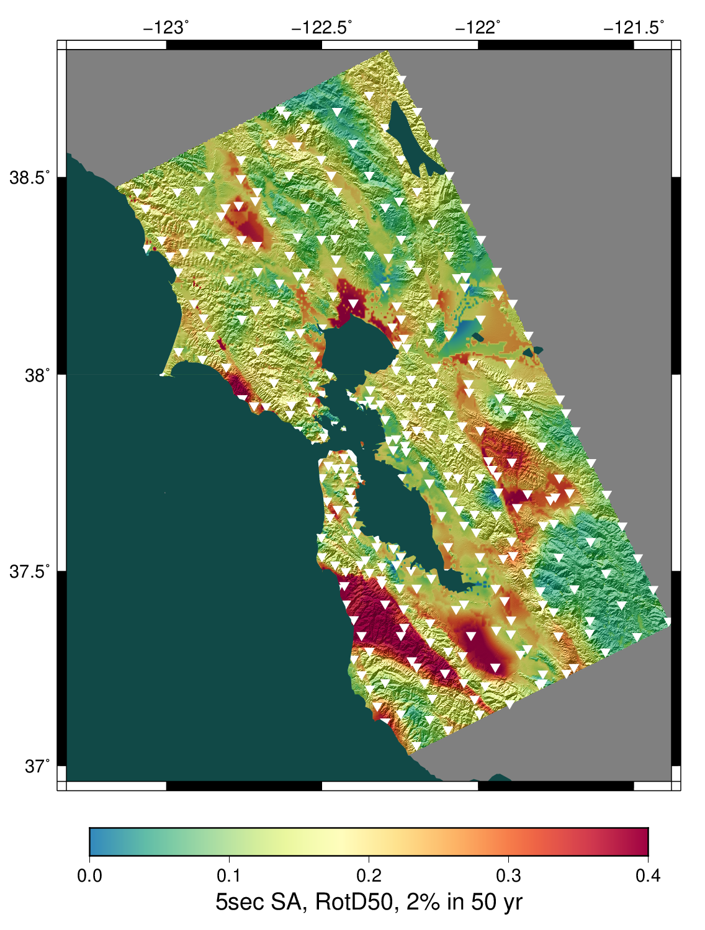
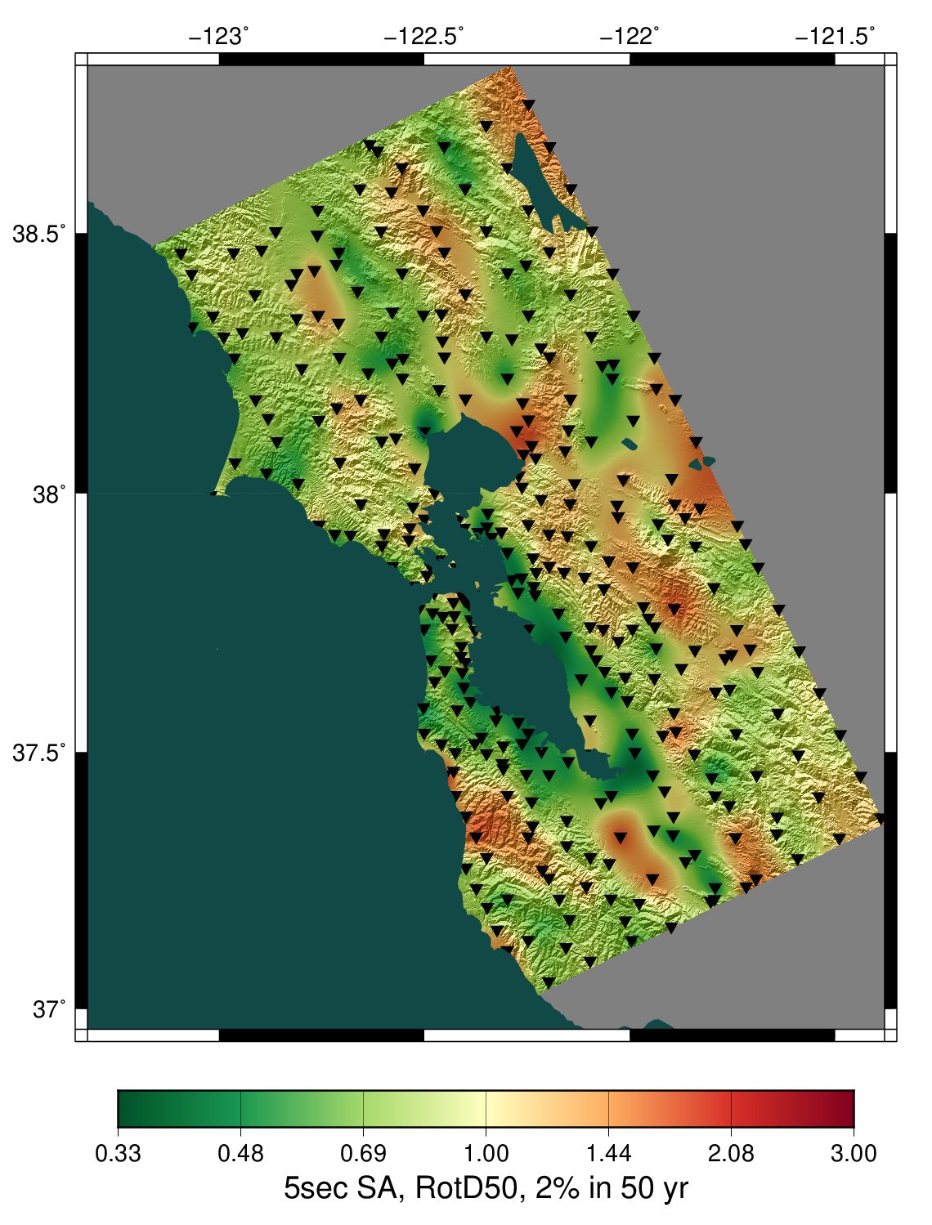
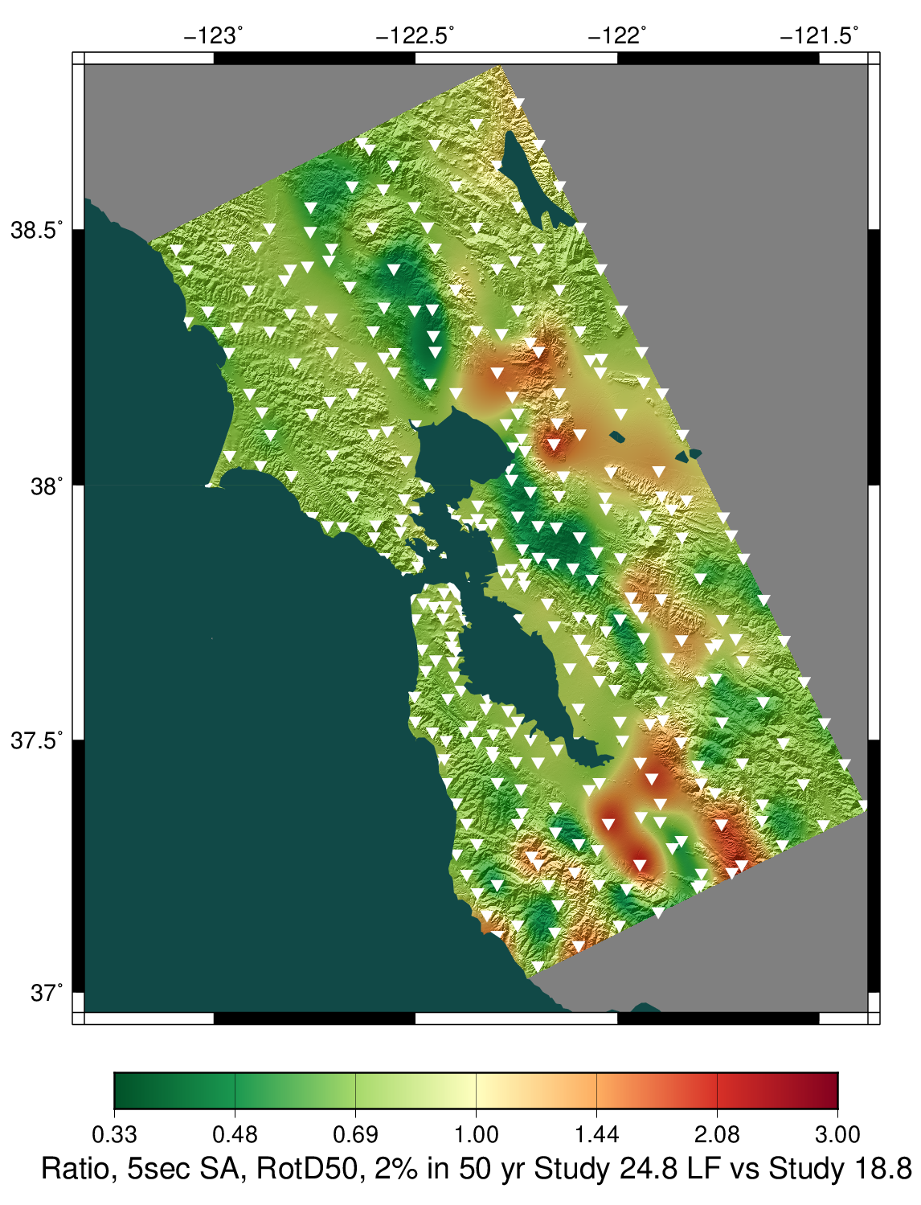
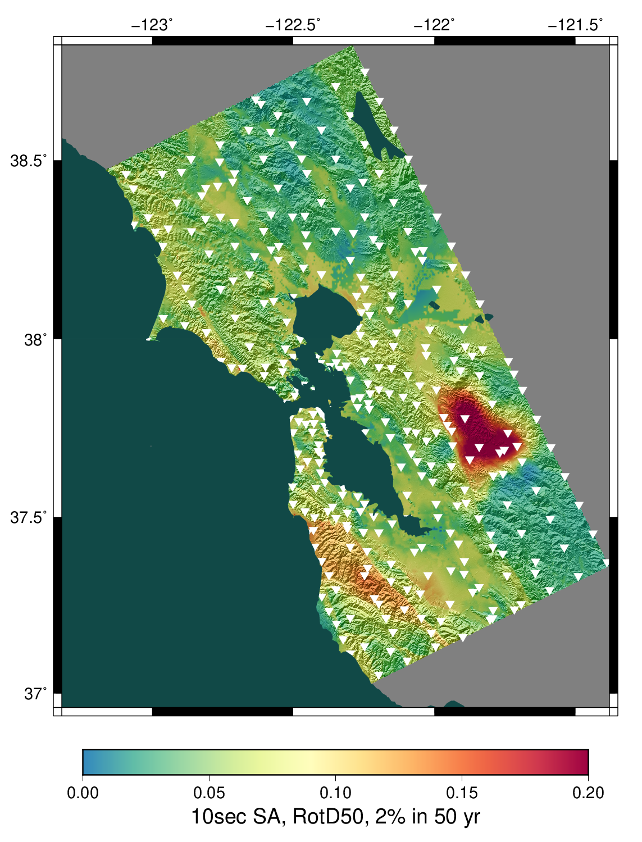
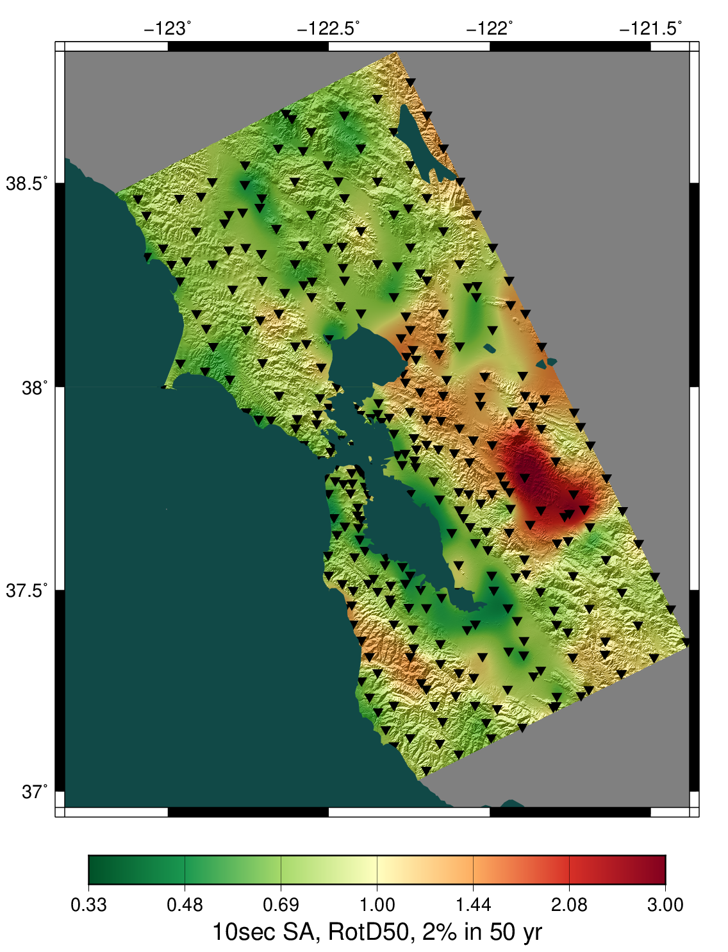
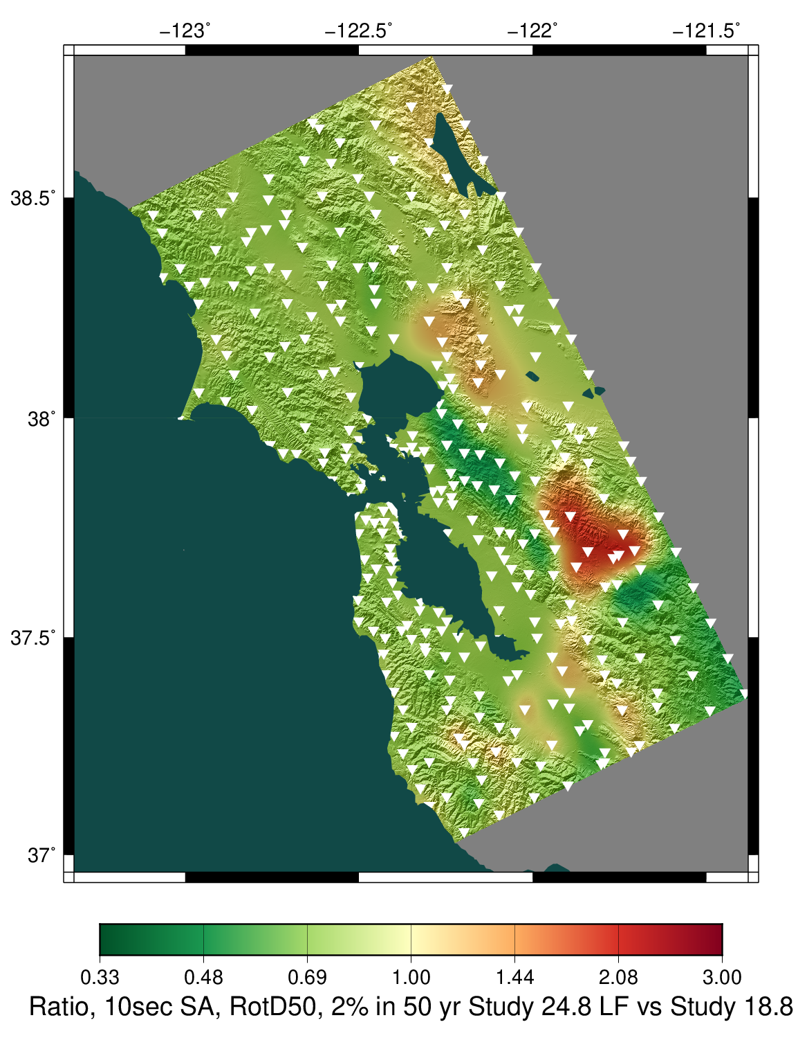
Low-frequency Hazard Maps
2s
2s
2s
CS18.8 velocity profile
CS24.8 velocity profile
3s
3s
3s
CS24.8
CS24.8
GMMs
CS24.8
CS18.8
CS24.8
CS24.8
GMMs
CS24.8
CS18.8
5s
5s
5s
10s
10s
10s
CS24.8
CS24.8
GMMs
CS24.8
CS18.8
CS24.8
GMMs
CS24.8
CS18.8
CS24.8
Statewide California Earthquake Center | www.scec.org

Slide 10
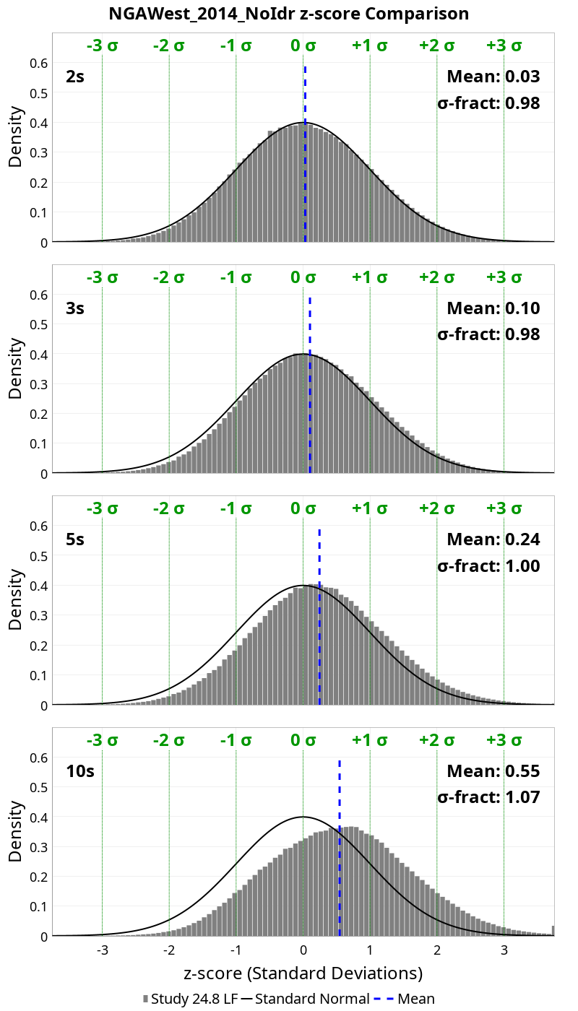
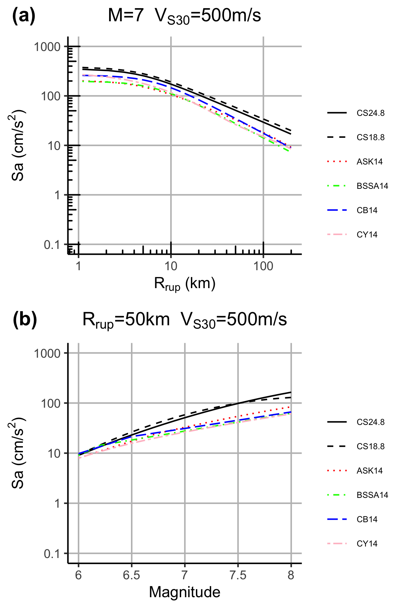
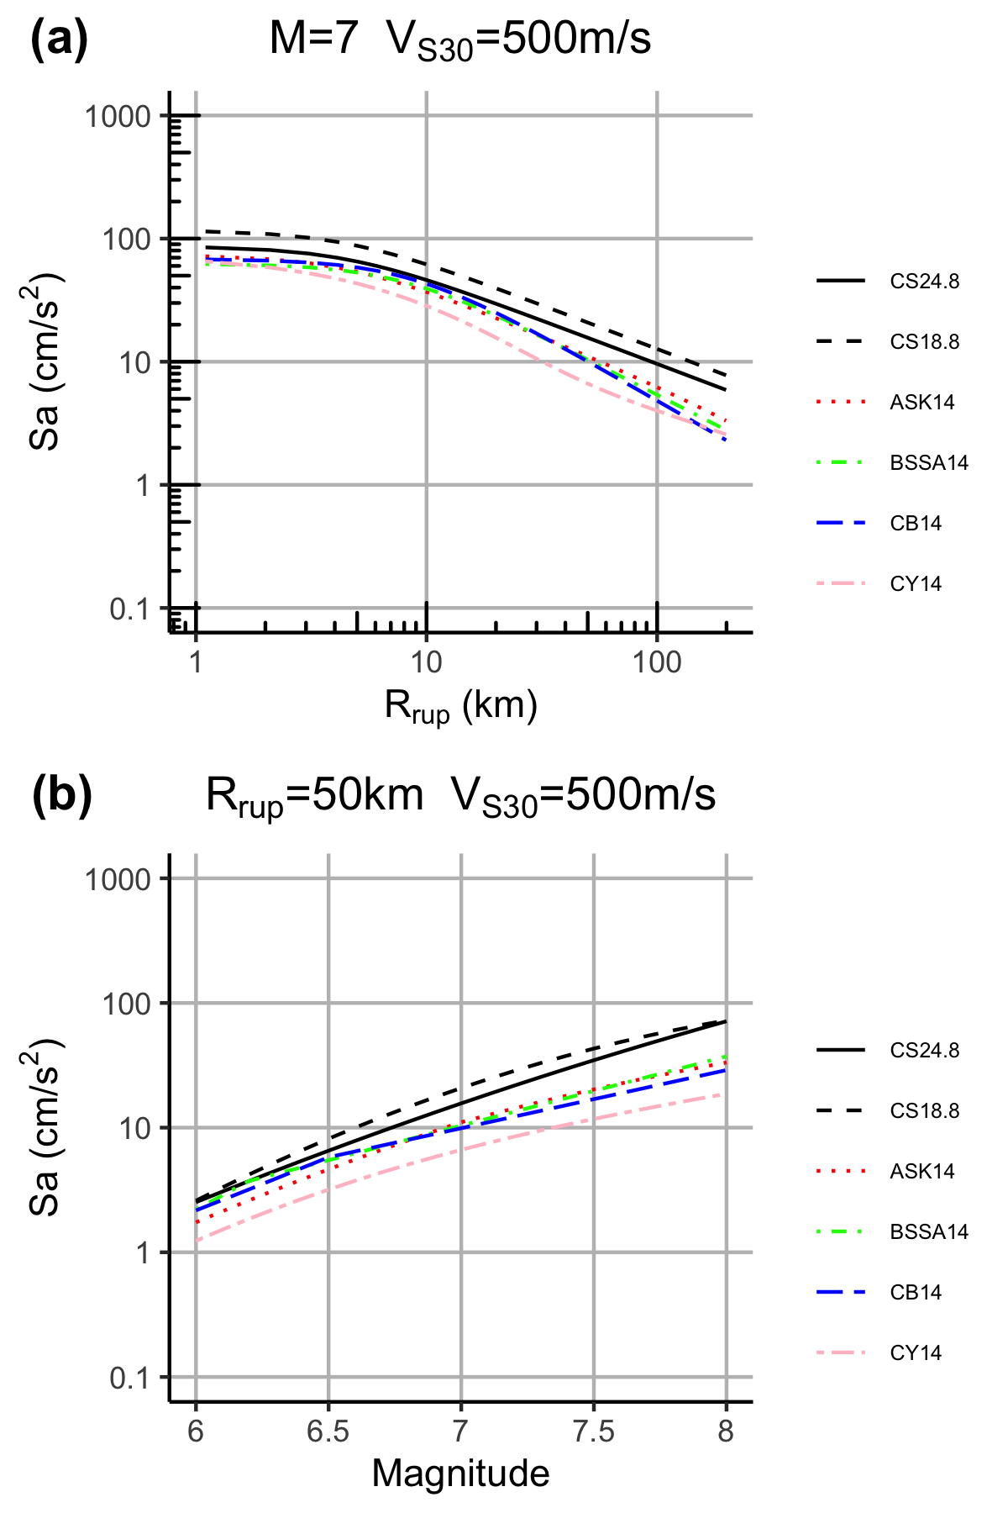
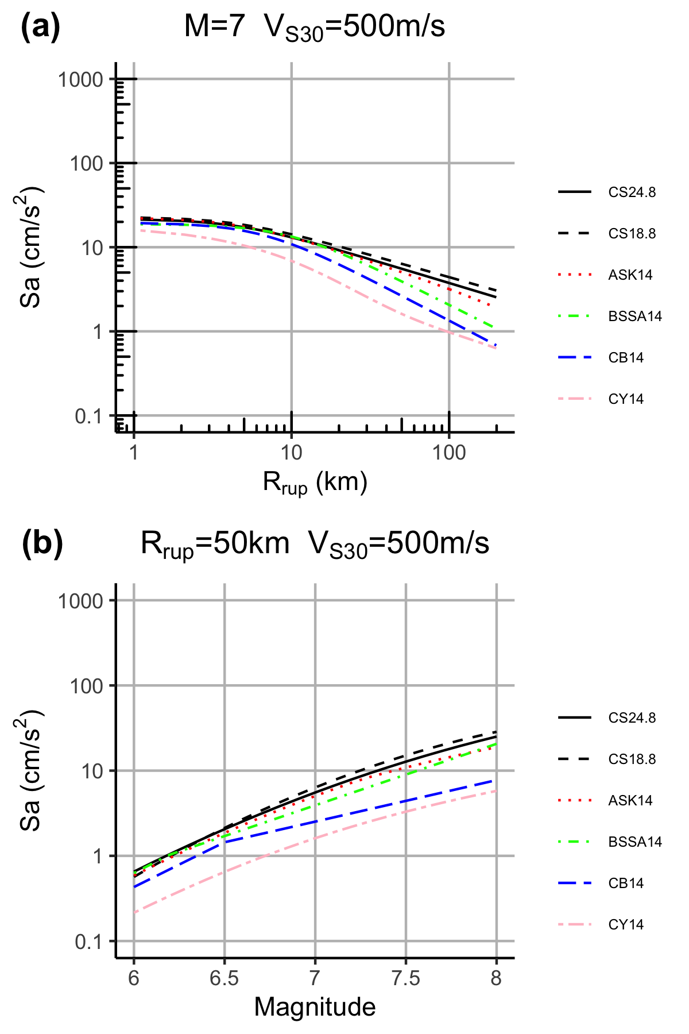
Low-frequency Aggregate Analyses
2 sec
5 sec
10 sec
Comparison of distance and magnitude scaling between CyberShake-derived GMM and other GMMs
Z-score distribution

Slide 11
Low-Frequency Site Terms
Site terms derived from CyberShake-derived GMM
At 2 and 5 sec, slightly higher in South and East Bay
At 10 sec, higher site terms in Livermore basin
2 sec
5 sec
10 sec

Slide 12
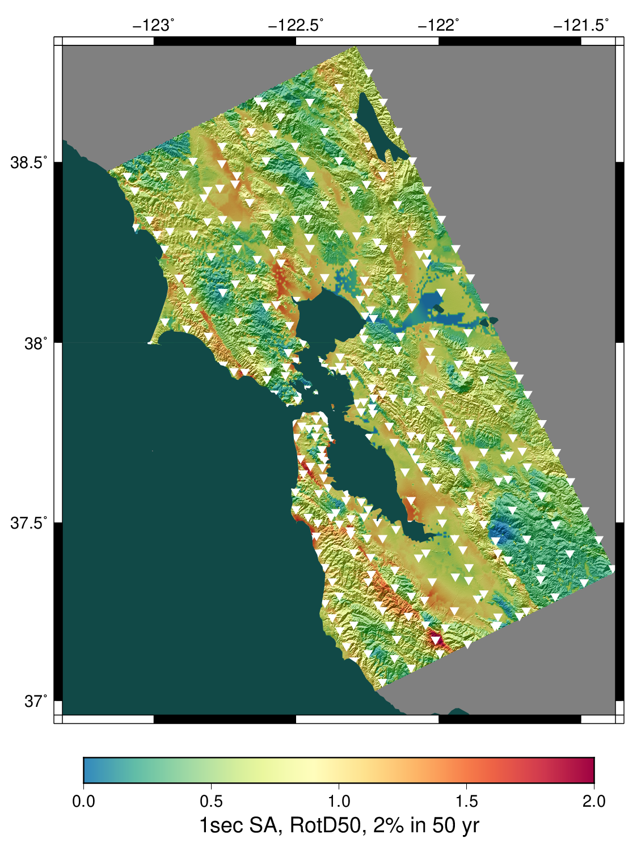
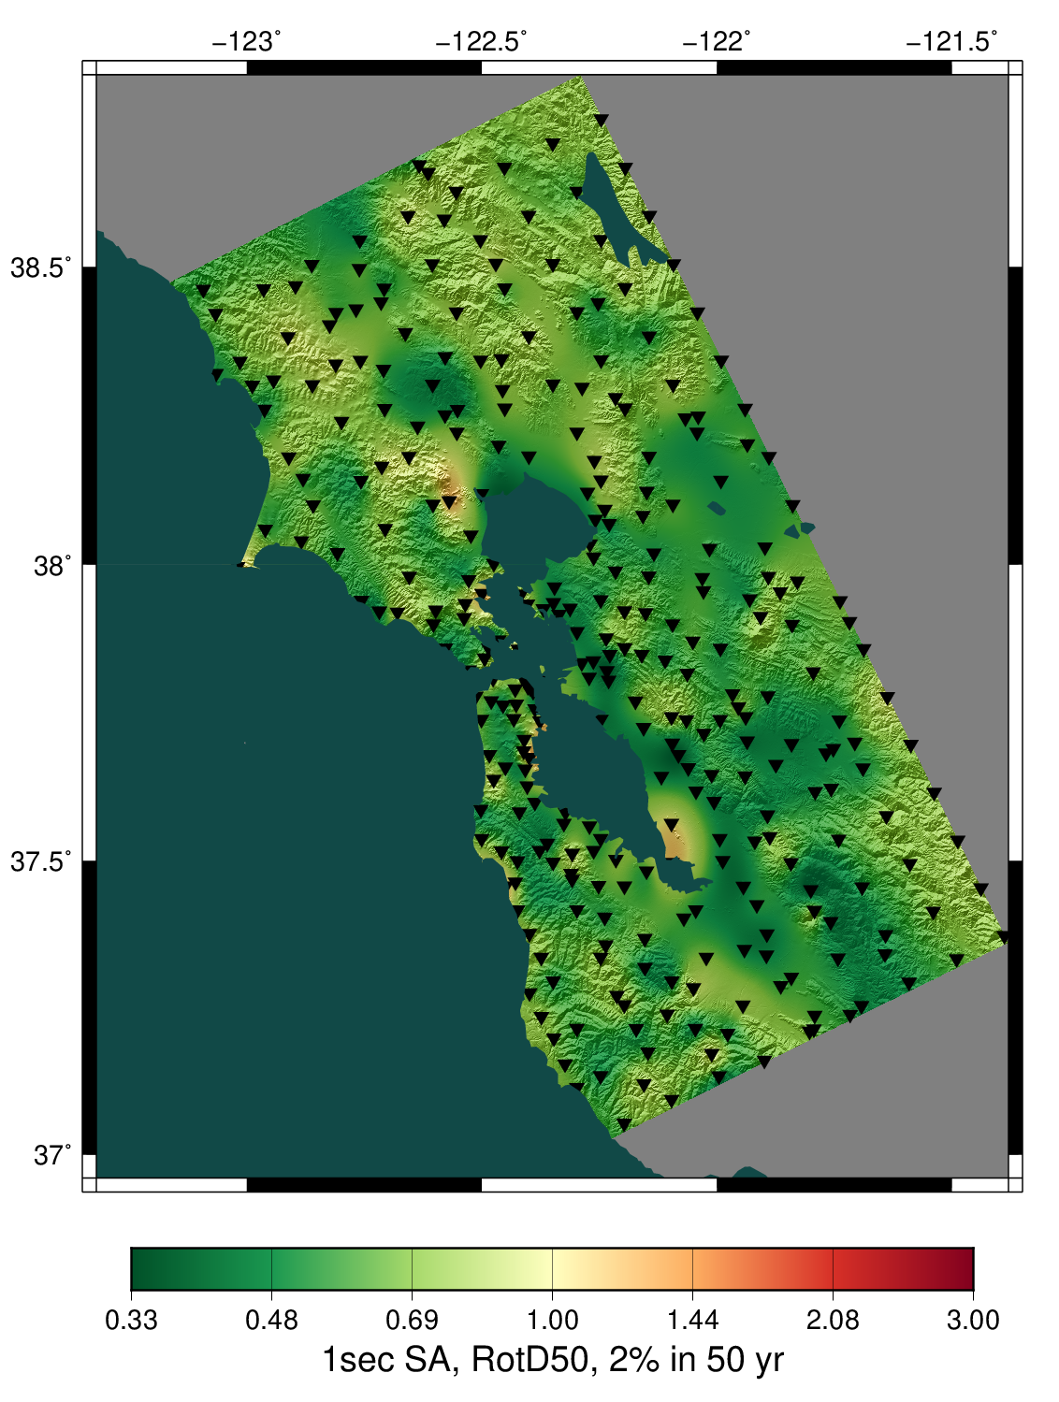
Broadband Data Products
1s
1s
CS24.8
GMMs
CS24.8
Z-score distribution

Slide 13
Next Steps
Short-term:
Continue Study 24.8 analysis
Improve community access to data products
Calculate Fourier spectra for all events
Medium-term:
Perform 2 Hz tests in small region of interest (will require code modifications)
Look at reducing minimum Vs
Long-term:
Ways to integrate non-linearity with reciprocity
Include topography
Let me know if you’d like access to data!

Slide 14
Thanks!

