Slide 1
The long-run computational challenges for using 3D simulations in seismic hazard analysis
Scott Callaghan

Slide 2
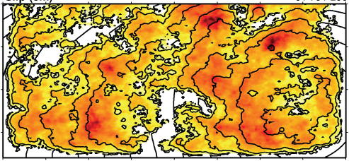
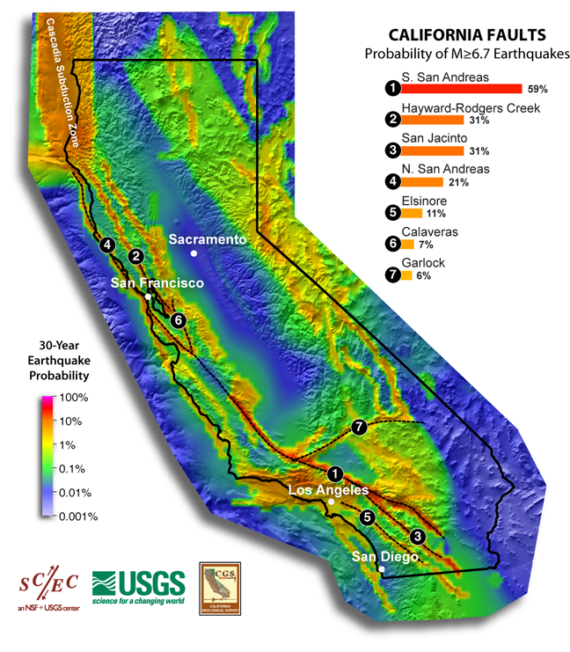
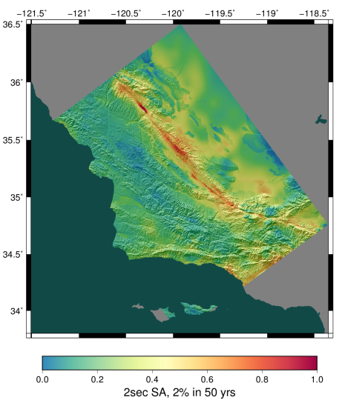
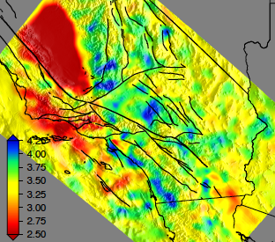
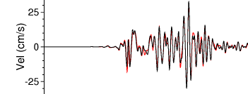
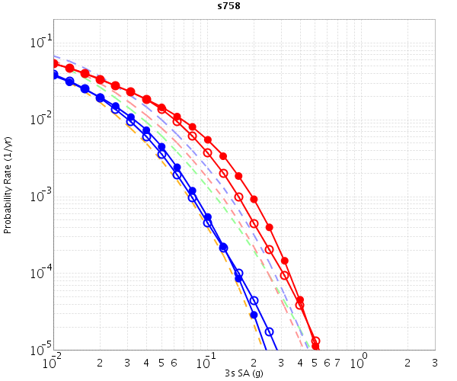
CyberShake Overview
Graves-Pitarka kinematic rupture generator
CyberShake Hazard Map
UCVM
Data
Product Generation
AWP-ODC
Seismogram Synthesis
12 TB
data transfer
Mesh generation
1 job per site
MPI, 1500-4000 cores
SGT computation
2 jobs per site
MPI, 200-800 GPUs
Post-processing
500,000 jobs per site
MPI master/worker, 3712 cores
Populate DB, construct images
6 jobs per site
Uniform California Earthquake Rupture Forecast
CVM-S4.26
z = 6 km
hazard curves
500,000 Seismograms
75M intensity measures
Community Velocity Model

Slide 3
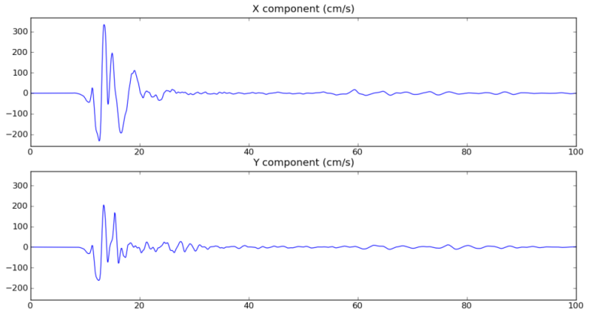
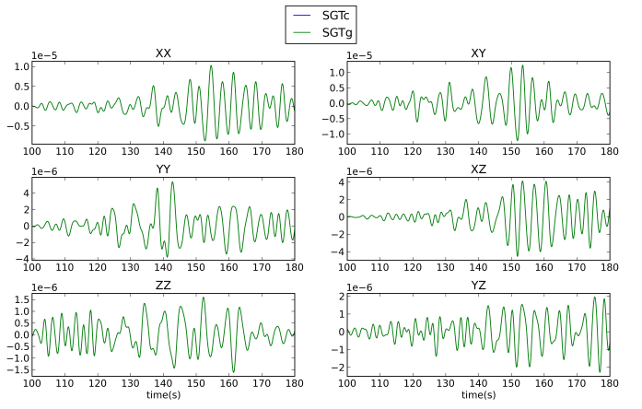
Reciprocity in CyberShake
CyberShake uses reciprocity to reduce computational cost
Impulse is placed at site of interest
2 Strain Green Tensor simulations are performed
In post-processing, SGT time-series is convolved with slip time history at each point on fault surface to produce seismogram
Non-linearity breaks reciprocity
*
Impulse
SGTs
Slip time history
Seismogram

Slide 4
Non-Linear CyberShake: Approximation
Pseudo-nonlinearity: continue with current workflow, adding additional non-linear approximations
New kinematic rupture descriptions could approximate non-linear source effects
Additional post-processing in reciprocity step could approximate non-linear crustal effects
Could calibrate against suites of full non-linear simulations to generate pseudo-nonlinear models

Slide 5
Non-linear CyberShake: Hybrid
Modify CyberShake to include forward simulations
Converting CyberShake to forward-only is expensive
Most recent Study 17.3 used 21.6 million core-hours
Running forward-only would have used ~1.1 billion
Less than 10% of sources account for more than 90% of the hazard
Even less than 10% at the rupture level
Combine forward-simulation of a small subset of events with reciprocity for the majority
3% forward (15,000 events) + 97% reciprocity = 51 million core-hours

Slide 6
Event Classification
Challenge becomes how to determine which events should be forward-simulated
For previously-run sites, can use previous disaggregation results
Source# % Contribution TotExceedRate SourceName
000112 28.44 1.1660034E-4 San Jacinto;SBV+SJV+A+C
000110 08.01 3.284774E-5 San Jacinto;SBV+SJV
000111 07.77 3.1859796E-5 San Jacinto;SBV+SJV+A
000094 07.09 2.9080562E-5 S. San Andreas;SM+NSB+SSB+BG+CO
000109 06.39 2.6198057E-5 San Jacinto;SBV
000079 04.62 1.894212E-5 S. San Andreas;NSB+SSB+BG+CO
000097 02.97 1.21608555E-5 S. San Andreas;SSB+BG+CO
000093 02.77 1.1355708E-5 S. San Andreas;SM+NSB+SSB+BG
000130 02.38 9.758109E-6 San Jacinto (SB to C)
000115 02.10 8.5908005E-6 San Jacinto;SBV+SJV+A+CC+B+SM
000086 02.05 8.392931E-6 S. San Andreas;PK+CH+CC+BB+NM+SM+NSB
000114 01.79 7.3234287E-6 San Jacinto;SBV+SJV+A+CC+B
...

Slide 7
Event Classification
For new sites / velocity models, can predict intensity measure and therefore predict disaggregation results
What GMPEs do
Can tolerate a moderate amount of error, especially by being inclusive
Use machine learning to classify events into forward-simulation or reciprocity
Very preliminary work suggests this is promising
Could mesh well with UCERF 3 ERF option
Classify into (GMPE, reciprocity, forward)

Slide 8
Conclusions
Want to continue to integrate new developments into CyberShake
Nonlinearity will be important especially at higher frequencies
Pseudo-nonlinearity or hybrid approaches may provide path forward
Questions?

