Slide 1
Utilization of Ground-Motion Simulations to Develop Long Period Spectral Acceleration Maps for Los Angeles Region
SCEC UGMS Committee Meeting
May 12, 2014

Slide 2
New Approach for Computing Long Period S_{a}
Use Ground Motions from 3-D Numerical Models to Develop Long Period S_{a} Maps
Application: L.A., SEA, SFO, SLC
ASCE 7-21 Standard

Slide 3
SCEC UGMS Committee - Approach
Generate Long-Period Sa Maps per PSHA/DSHA Procedures in Ch. 21, ASCE 7-10
Substitute simulations for GMPEs
Use SCEC CyberShake: T ≥ 1 sec

Slide 4
Secondary End Product (Primary Output)
Simulated Time Histories
a
t

Slide 5
Model Regional 3-D Effects on Long Period Motions
a(t)
Basin
Fault
Rock

Slide 6
2013 NGA Equations with Basin Depth Terms
Abrahamson et al – Z1.0
Boore et al – Z1.0
Campbell & Bozorgnia – Z2.5
Chiou & Youngs – Z1.0
Site
Z
1.0
Depth
V = 1 km/s
S
Z
2.5
V = 2.5 km/s
S
Basin Profile

Slide 7
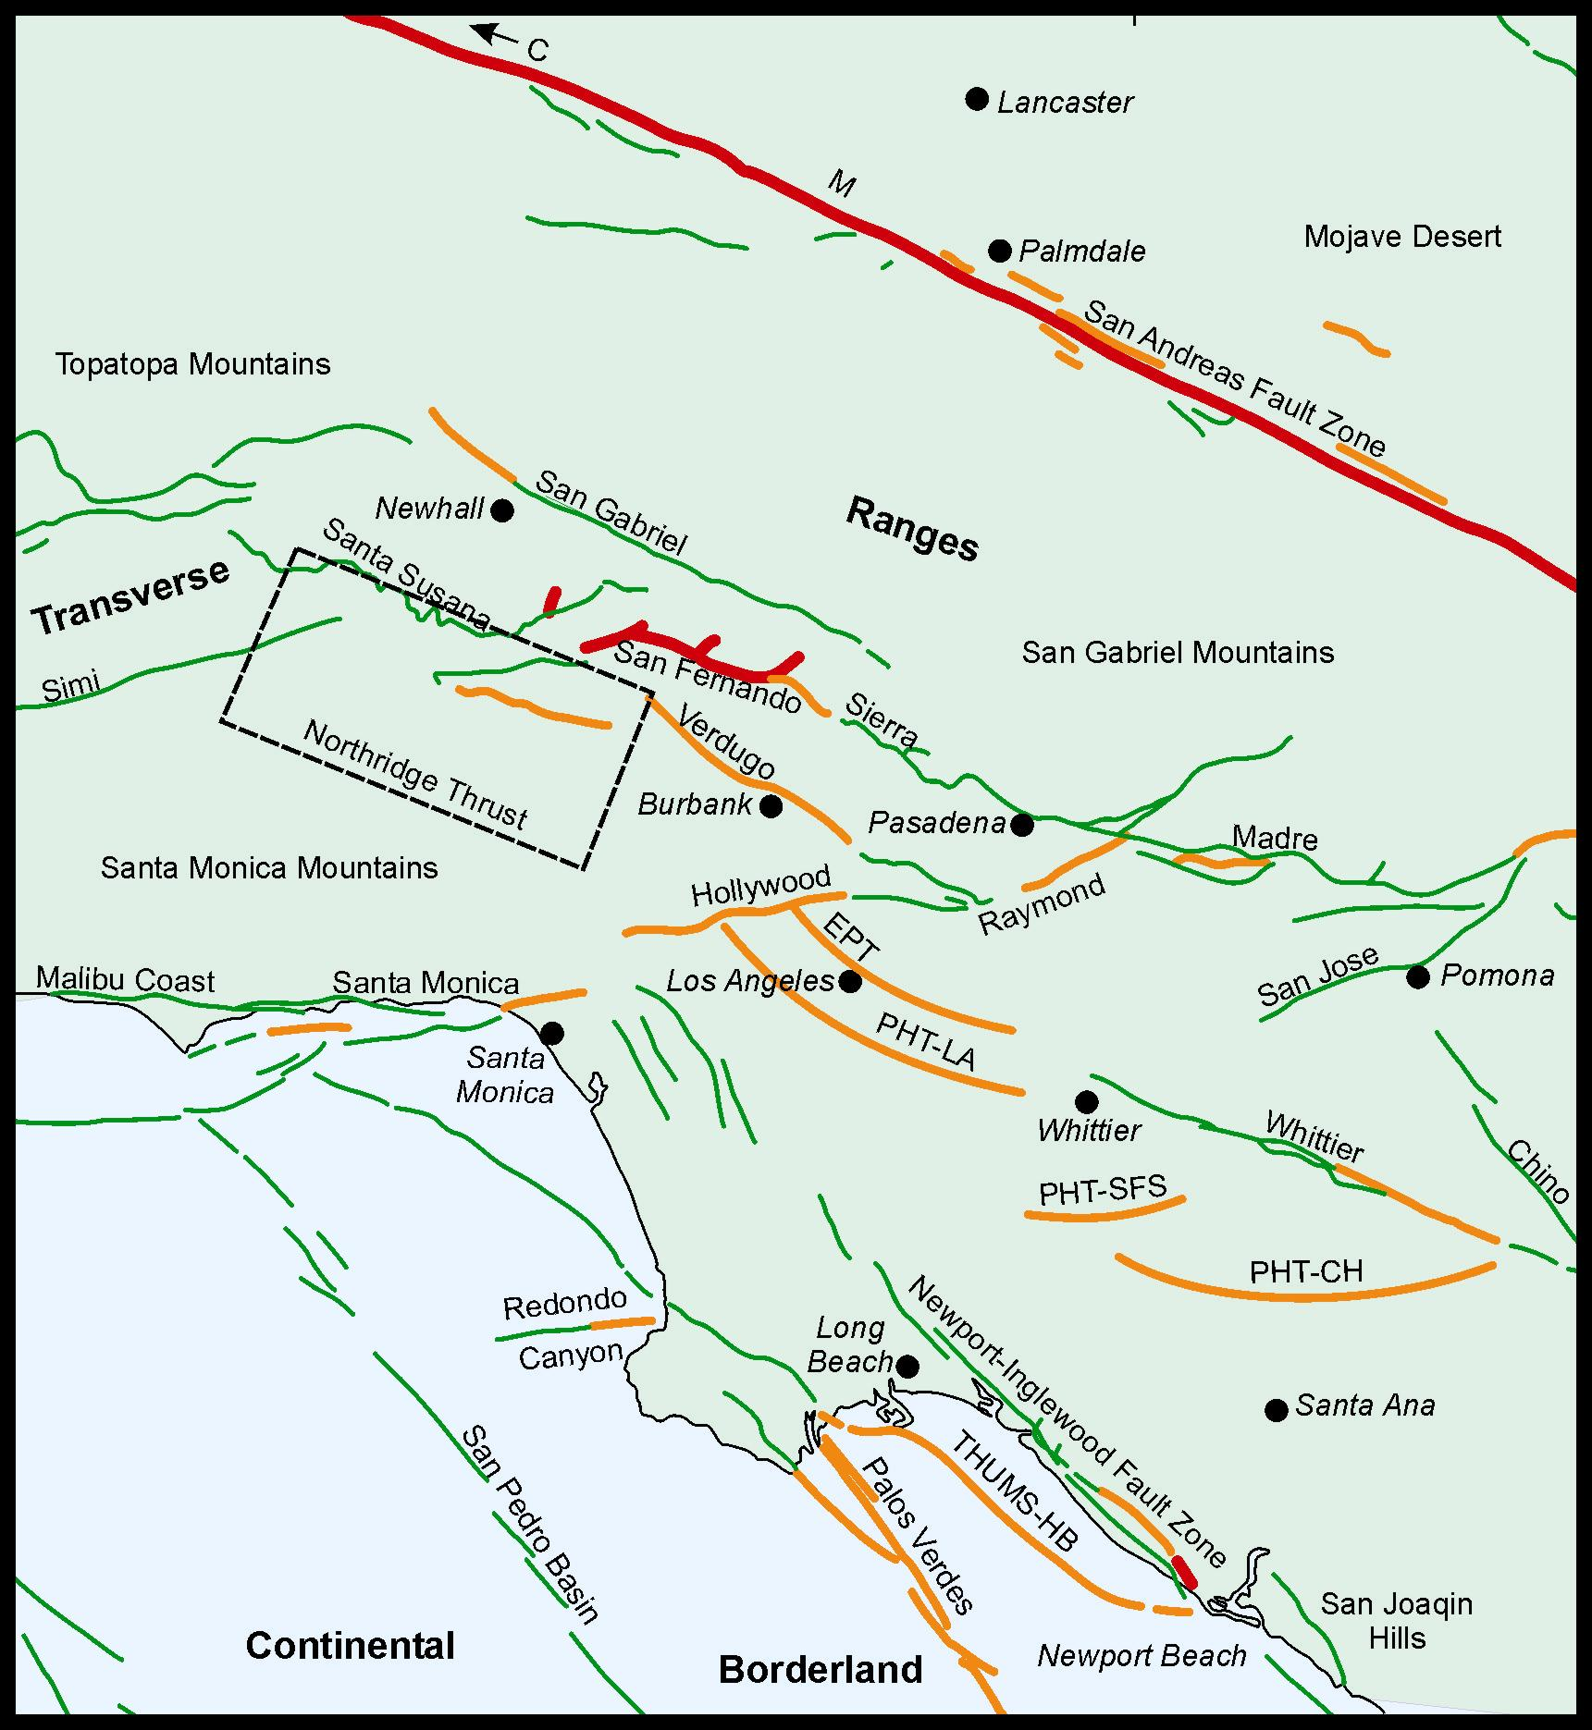
Limitation of Empirical Approach – Los Angeles
Lack of Local Strong Motion Records
(Only 1994 M6.7 Northridge & 1971 M6.6 San Fernando EQ)

Slide 8
Simulation Approach
Characterize fault Mw recurrence (SCEC UCERF)
Perform simulations
3-comp. accelerograms
response spectra, S_{a}(T)
median S_{a}(T)
Select σ_{ln}
Proceed with PSHA/DSHA

Slide 9
L.A. Pilot Study End Poducts
Contour Maps of S_{a}(T)
for
Selected T in 1 ≤ T ≤ 10 sec range

Slide 10
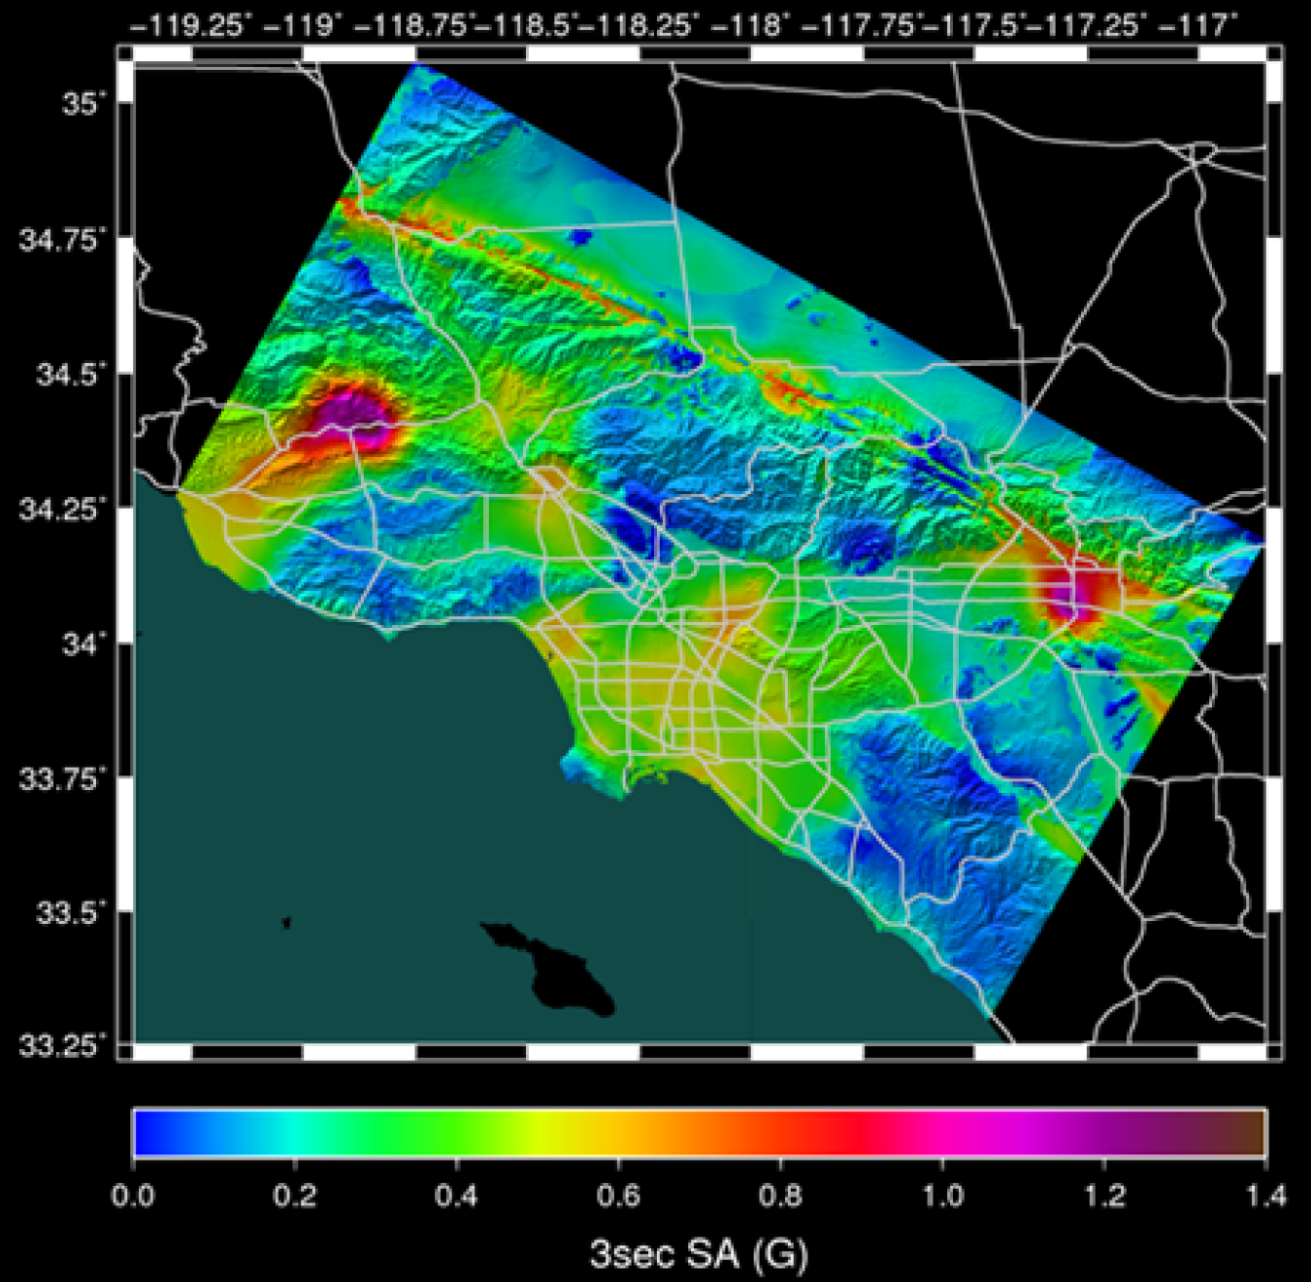
Los Angeles Region Hazard Map, 2% in 50-yr S_{a}(3 sec) Graves et al. (2010) CyberShake Simulations
Graves et al. (2010) – Fig. 9

Slide 11
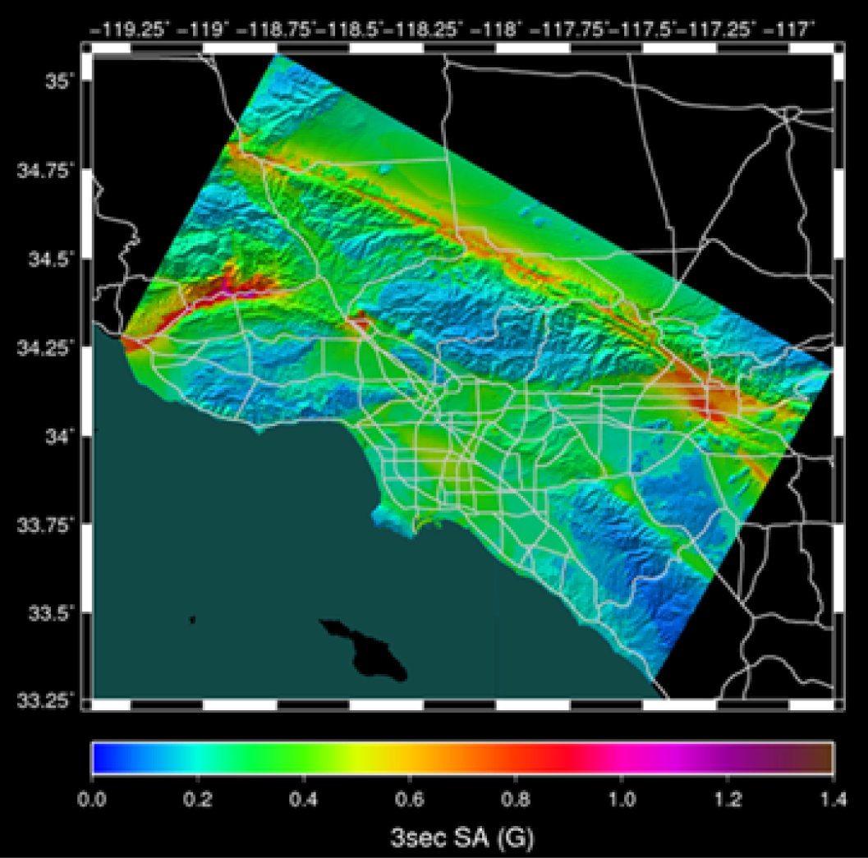
Los Angeles Region Hazard Map, 2% in 50-yr S_{a}(3 sec) Campbell & Bozorgnia (2008) NGA eqn.
Graves et al. (2010) – Fig. 9

Slide 12
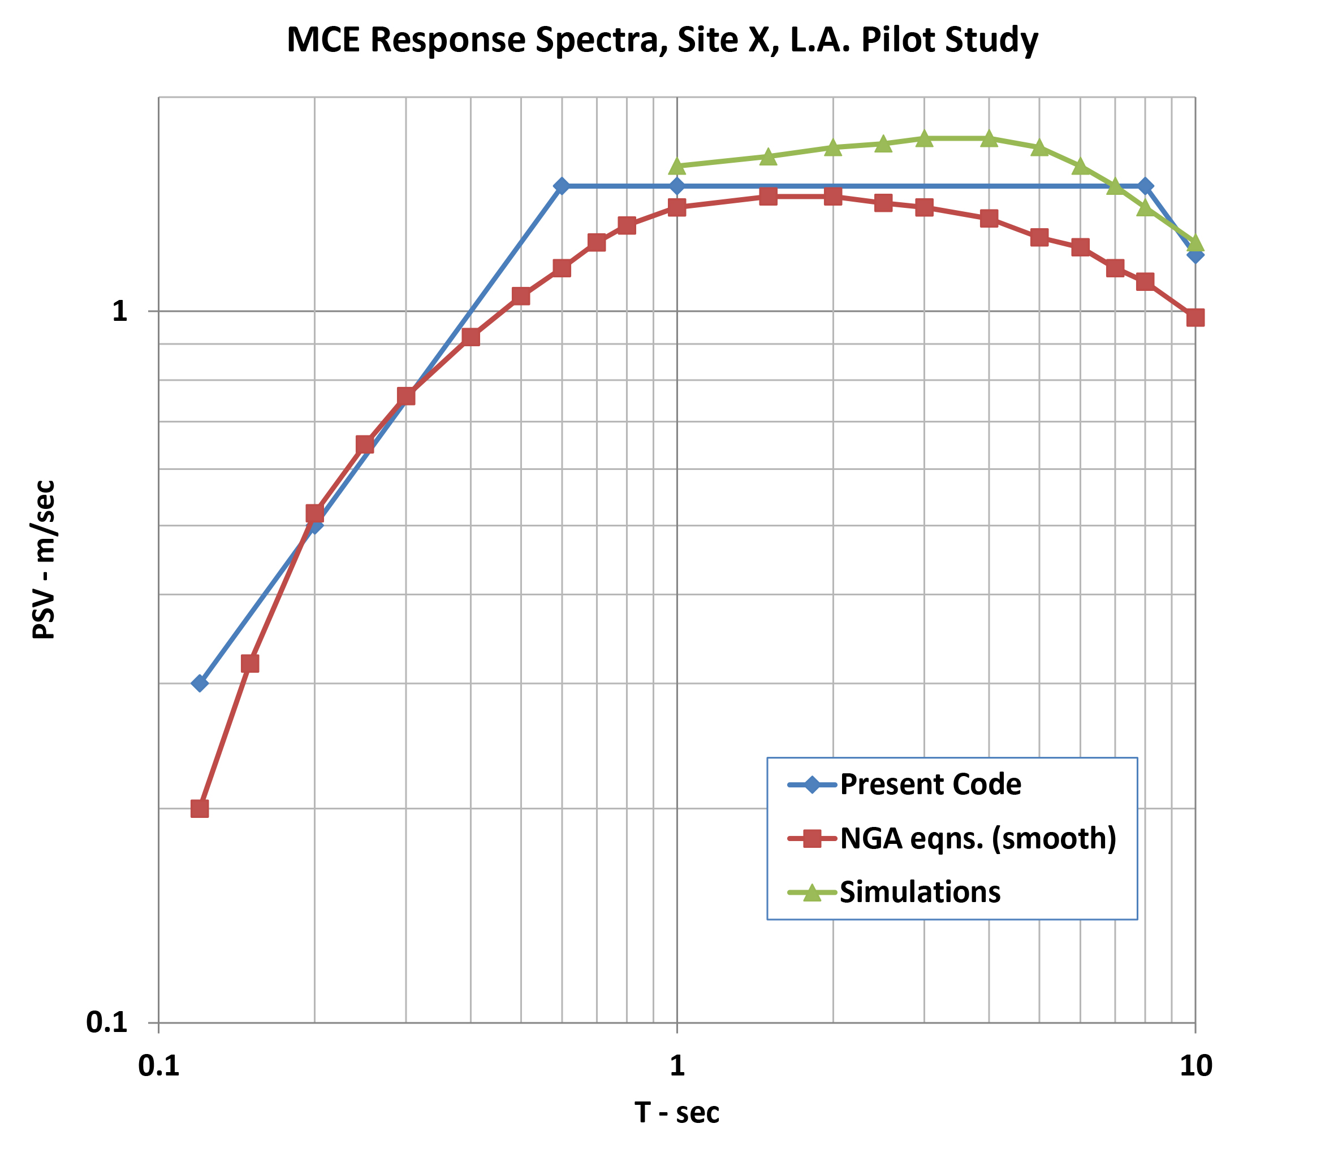
MCE Response Spectra, Site X, L.A. Pilot Study

Slide 13
Path Forward
Technical Approach – Parallel Tracks
CyberShake Simulations
NGA-West2 GMPE revisions based on simulations for L.A. application
Management Approach
SCEC UGMS – C. Crouse
SCEC GMSV – N. Luco
Form NEHRP IT Group – Next Code Cycle

Slide 14
Today’s Meeting Focus
Cybershake Platform
Background
Methodology
Advantages
Results to date
Future work (direction from UGMS)

